Slide 1



Noida Institute of Engineering and Technology, Greater Noida
Relational data Model and Language
Introduction to SQL
Unit: 2
DBMS
Vikrant Malik
Assistant Professor
(IT)
Course Details (B Tech 5th Sem)

Slide 2
Content
Relational data model concepts
Integrity constraints
Key constraints
Domain constraints
Introduction to SQL
SQL operators and their procedures
Tables
SQL data types
Types of SQL
SQL queries and sub queries
Aggregate functions
Operations (Insert, delete and update)

Slide 3
Course Objective
List and explain the fundamental concepts of a relational database system
Knowledge of DBMS, both in terms of use and implementation/design.
Experience with SQL and Manipulate a database using SQL
Increased proficiency with the programming language C++.
Experience working as part of team v Experience with analysis and design of (DB) software
Assess the quality and ease of use of data modeling and diagramming tools
Utilize a wide range of features available in a DBMS package.

Slide 4
Prerequisite and Recap
A good background in DBMS fundamentals is required.
Students should be comfortable with the relational model, SQL, and the basic functions of database systems.
Students should also be capable of implementing a large, complex system on UNIX in C or C++.
The proper understanding of data structures and algorithms will help you to understand the DBMS quickly.
Recap
In last unit we studied about
Data base and file system
Database concept and architecture
Database languages
ER modeling concepts

Slide 5
Course Outcome
S. NO. | Course Outcomes | Blooms’ Taxonomy
KCS501.1 | Apply knowledge of database for real life applications. | K3
KCS501.2 | Apply query processing techniques to automate the real time problems of databases. | K3, K4
KCS501.3 | Identify and solve the redundancy problem in database tables using normalization | K2, K3
KCS501.4 | Understand the concepts of transactions, their processing so they will familiar with broad range of database management issues including data integrity, security and recovery. | K2, K4
KCS501.5 | Design, develop and implement a small database project using database tools. | K3, K6

Slide 6
CO-PO and PSO Mapping
CO-PO correlation matrix of DBMS(KCS 501)
 | PO1 | PO2 | PO3 | PO4 | PO5 | PO6 | PO7 | PO8 | PO9 | PO10 | PO11 | PO12
KCS501.1 | 2 | 2 | 3 | 3 | 3 | 2 | 3 | 2 | 2 | 2 | 2 | 3
KCS501.2 | 3 | 3 | 3 | 2 | 2 | 2 | 2 | 2 | 2 | 2 | 2 | 3
KCS501.3 | 2 | 3 | 3 | 3 | 3 | 2 | 2 | 2 | 2 | 2 | 2 | 2
KCS501.4 | 2 | 3 | 2 | 2 | 2 | 2 | 2 | 2 | 2 | 3 | 2 | 2
KCS501.5 | 2 | 3 | 2 | 2 | 2 | 3 | 2 | 2 | 3 | 2 | 2 | 2
AVG | 2.20 | 2.80 | 2.60 | 2.40 | 2.40 | 2.20 | 2.20 | 2.00 | 2.20 | 2.20 | 2.00 | 2.40
Mapping of Program Specific Outcomes and Course Outcomes
 | Program Specific Outcomes
 | PSO1 | PSO2 | PSO3 | PSO4
KCS-501.1 | 3 | 1 | 3 | 1
KCS-501.2 | 3 | 1 | 3 | 1
KCS-501.3 | 3 | 1 | 3 | 1
KCS-501.4 | 3 | 1 | 3 | 1
KCS-501.5 | 3 | 1 | 3 | 1
AVG | 3.00 | 1.00 | 3.00 | 1.00

Slide 7
Syllabus of Unit 2
Relational data Model and Language: Relational data model concepts, integrity constraints, entity integrity, referential integrity, Keys constraints, Domain constraints, relational algebra, relational calculus, tuple and domain calculus.
Introduction on SQL: Characteristics of SQL, advantage of SQL. SQl data type and literals. Types of SQL commands. SQL operators and their procedure. Tables, views and indexes. Queries and sub queries. Aggregate functions. Insert, update and delete operations, Joins, Unions, Intersection, Minus, Cursors, Triggers, Procedures in SQL/PL SQL

Slide 8
Relational Data Model in DBMS (CO2)
The relational model represents the database as a collection of relations. A relation is nothing but a table of values. Every row in the table represents a collection of related data values. These rows in the table denote a real-world entity or relationship.
The table name and column names are helpful to interpret the meaning of values in each row. The data are represented as a set of relations. In the relational model, data are stored as tables. However, the physical storage of the data is independent of the way the data are logically organized.
Some popular Relational Database management systems are:
DB2 and Informix Dynamic Server - IBM
Oracle and RDB – Oracle
SQL Server and Access - Microsoft

Slide 9
Relational Model Concepts (CO2)
Attribute: Each column in a Table. Attributes are the properties which define a relation. e.g., Student_Rollno, NAME,etc.
Tables – In the Relational model the, relations are saved in the table format. It is stored along with its entities. A table has two properties rows and columns. Rows represent records and columns represent attributes.
Tuple – It is nothing but a single row of a table, which contains a single record.
Relation Schema: A relation schema represents the name of the relation with its attributes.
Degree: The total number of attributes which in the relation is called the degree of the relation (unary, Binary, n-ary etc.).

Slide 10
Relational Model Concepts
Cardinality: Total number of relationship instances of an entity (1-1,1-m, m-n, m-1).
Column: The column represents the set of values for a specific attribute.
Relation instance – Relation instance is a finite set of tuples in the RDBMS system. Relation instances never have duplicate tuples.
Relation key - Every row has one, two or multiple attributes, which is called relation key.
Attribute domain – Every attribute has some pre-defined value and scope which is known as attribute domain

Slide 11
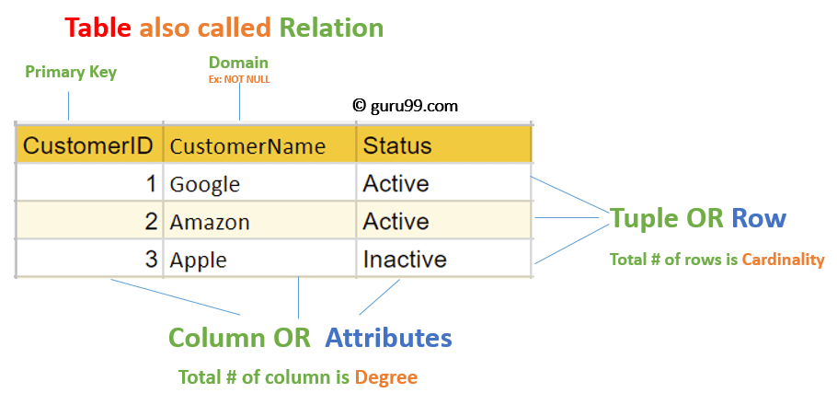
Relational Model Concepts

Slide 12
Characteristics of Relation (CO2)
Ordering of Tuples in a Relation
Ordering of Values in a relation/Ordering of attributes in a Relation
Values and NULLs in the Tuples
Interpretation (Meaning) of a Relation.

Slide 13
Characteristics of Relations
1. Ordering of Tuples in a Relation
A relation is defined as a set of tuples. Mathematically, elements of a set have no order among them; hence, tuples in a relation do not have any particular order. In other words, a relation is not sensitive to the ordering of tuples.
However, in a file, records are physically stored on disk (or in memory), so there always is an order among the records. This ordering indicates first, second, ith, and last records in the file. Similarly, when we display a relation as a table, the rows are displayed in a certain order.

Slide 14
Characteristics of Relations (CO2)
2. Ordering of Values within a Tuple/ Ordering of attributes in a Relation
The ordering of attributes is not important, because the attribute name appears with its value.
This makes sense at an abstract level, since there really is no reason to prefer having one attribute value appear before another in a tuple.
When the attribute name and value are included together in a tuple, it is known as self-describing data, because the description of each value (attribute name) is included in the tuple.

Slide 15
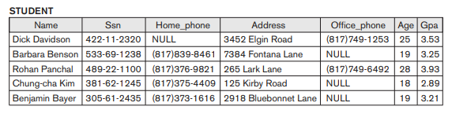
Characteristics of Relations (CO2)
Ordering of Values within a Tuple
t = < (Name, Dick Davidson),(Ssn, 422-11-2320),(Home_phone, NULL),(Address, 3452 Elgin Road), (Office_phone, (817)749-1253),(Age, 25),(Gpa, 3.53)>
t = < (Address, 3452 Elgin Road),(Name, Dick Davidson),(Ssn, 422-11-2320),(Age, 25), (Office_phone, (817)749-1253),(Gpa, 3.53),(Home_phone, NULL)>

Slide 16
Characteristics of Relations (CO2)
We will mostly use the first definition of relation, where the attributes are ordered in the relation schema and the values within tuples are similarly ordered, because it simplifies much of the notation.

Slide 17
Characteristics of Relations
3. Values and NULLs in the Tuples.
Each value in a tuple is an atomic value; that is, it is not divisible into components within the framework of the basic relational model. Hence, composite and multivalued attributes are not allowed.
This model is sometimes called the flat relational model.
Hence, multivalued attributes must be represented by separate relations, and composite attributes are represented only by their simple component attributes in the basic relational model.

Slide 18
Characteristics of Relations
Values and NULLs in the Tuples
An important concept is that of NULL values, which are used to represent the values of attributes that may be unknown or may not apply to a tuple. A special value, called NULL, is used in these cases.
some STUDENT tuples have NULL for their office phones because they do not have an office (that is, office phone does not apply to these students)
Example

Slide 19
Characteristics of Relations
4. Interpretation (Meaning) of a Relation.
The relation schema can be interpreted as a declaration or a type of assertion.
For example, the schema of the STUDENT relation of asserts that, in general, a student entity has a
(Name, Ssn, Home_phone, Address, Office_phone, Age, and Gpa).
Each tuple in the relation can then be interpreted as a fact or a particular instance of the assertion.

Slide 20
Characteristics of Relations
4. Interpretation (Meaning) of a Relation.
For example, the fifth tuple in asserts the fact that there is a STUDENT whose Name is Benjamin Bayer, Ssn is 305-61-2435, Age is 19, and so on.

Slide 21
Integrity Constraints
Integrity constraints are a set of rules. It is used to maintain the quality of information.
Integrity constraints ensure that the data insertion, updating, and other processes have to be performed in such a way that data integrity is not affected.
Thus, integrity constraint is used to guard against accidental damage to the database.

Slide 22
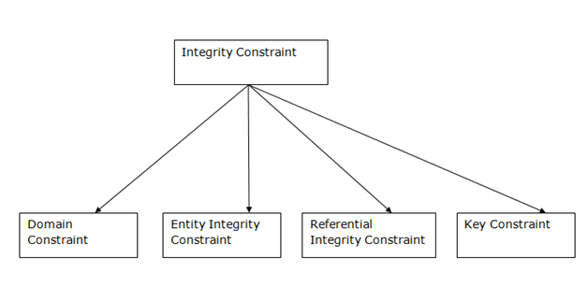
Types of Integrity Constraint

Slide 23
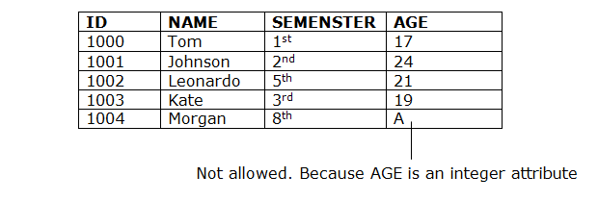
Domain constraints
Domain constraints can be defined as the definition of a valid set of values for an attribute.
The data type of domain includes string, character, integer, time, date, currency, etc. The value of the attribute must be available in the corresponding domain.

Slide 24
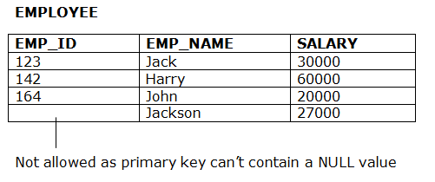
Entity integrity constraints
The entity integrity constraint states that primary key value can't be null.
This is because the primary key value is used to identify individual rows in relation and if the primary key has a null value, then we can't identify those rows.
A table can contain a null value other than the primary key field.

Slide 25
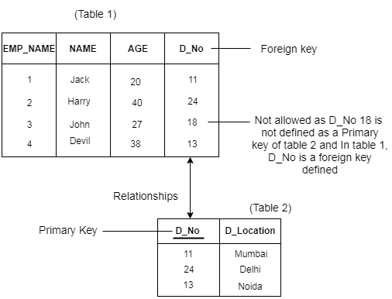
Referential Integrity Constraints
A referential integrity constraint is specified between two tables.
In the Referential integrity constraints, if a foreign key in Table 1 refers to the Primary Key of Table 2, then every value of the Foreign Key in Table 1 must be null or be available in Table 2.

Slide 26
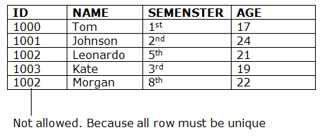
Key constraints
Keys are the entity set that is used to identify an entity within its entity set uniquely.
An entity set can have multiple keys, but out of which one key will be the primary key. A primary key can contain a unique and null value in the relational table.

Slide 27
Codd’s 12 Rules
Dr Edgar F. Codd, after his extensive research on the Relational Model of database systems, came up with twelve rules of his own, which according to him, a database must obey in order to be regarded as a true relational database.
These rules can be applied on any database system that manages stored data using only its relational capabilities. This is a foundation rule, which acts as a base for all the other rules.
Rule 0: The foundation rule
For any system that is advertised as, or claimed to be, a relational data base management system, that system must be able to manage data bases entirely through its relational capabilities.

Slide 28
Codd’s 12 Rules (contd..)
Rule 1: Information Rule
The data stored in a database, may it be user data or metadata, must be a value of some table cell. Everything in a database must be stored in a table format.
Rule 2: Guaranteed Access Rule
Every single data element (value) is guaranteed to be accessible logically with a combination of table-name, primary-key (row value), and attribute-name (column value). No other means, such as pointers, can be used to access data.
Rule 3: Systematic Treatment of NULL Values
The NULL values in a database must be given a systematic and uniform treatment. This is a very important rule because a NULL can be interpreted as one the following − data is missing, data is not known, or data is not applicable.

Slide 29
Codd’s 12 Rules (contd..)
Rule 4: Active Online Catalog
The structure description of the entire database must be stored in an online catalog, known as data dictionary, which can be accessed by authorized users. Users can use the same query language to access the catalog which they use to access the database itself.
Rule 5: Comprehensive Data Sub-Language Rule
A database can only be accessed using a language having linear syntax that supports data definition, data manipulation, and transaction management operations. This language can be used directly or by means of some application. If the database allows access to data without any help of this language, then it is considered as a violation.

Slide 30
Codd’s 12 Rules (contd..)
Rule 6: View Updating Rule
All the views of a database, which can theoretically be updated, must also be updatable by the system.
Rule 7: High-Level Insert, Update, and Delete Rule
A database must support high-level insertion, updation, and deletion. This must not be limited to a single row, that is, it must also support union, intersection and minus operations to yield sets of data records.
Rule 8: Physical Data Independence
The data stored in a database must be independent of the applications that access the database. Any change in the physical structure of a database must not have any impact on how the data is being accessed by external applications.

Slide 31
Codd’s 12 Rules (contd..)
Rule 9: Logical Data Independence
The logical data in a database must be independent of its user’s view (application). Any change in logical data must not affect the applications using it. For example, if two tables are merged or one is split into two different tables, there should be no impact or change on the user application. This is one of the most difficult rule to apply.
Rule 10: Integrity Independence
A database must be independent of the application that uses it. All its integrity constraints can be independently modified without the need of any change in the application. This rule makes a database independent of the front-end application and its interface.

Slide 32
Codd’s 12 Rules (contd..)
Rule 11: Distribution Independence
The end-user must not be able to see that the data is distributed over various locations. Users should always get the impression that the data is located at one site only. This rule has been regarded as the foundation of distributed database systems.
Rule 12: Non-Subversion Rule
If a system has an interface that provides access to low-level records, then the interface must not be able to subvert the system and bypass security and integrity constraints.

Slide 33
RELATIONAL ALGEBRA

Slide 34
Content
Relational Algebra
Basic of Relational Database
Relational Algebra
Importance of Relational Algebra
Relational Query Language and their types
Relational Algebra Operations

Slide 35
Basic of relational database
So far
we have seen what a database is,
what is the features of database,
how to gather requirements and how to put them in ER diagrams,
how to convert them into tables and their columns, set their constraints etc.

Slide 36
Basic of relational database
Once we have database ready users will start using them.
But how will they access the database? Most of the time they access the data by using some applications.
These applications will communicate to database by SQL and DBMS is responsible for managing the application and SQL intact.
SQL has its own querying methods to interact with database. But how these queries work in the database?
These queries work similar to relational algebra that we have in mathematics.
Note :- Relational algebra mainly provides theoretical foundation for relational databases and SQL.

Slide 37
Relational Algebra
The basic set of operations for the relational model is known as the relational algebra. These operations enable a user to specify basic retrieval requests.
Working of relational Algebra
The result of a retrieval is a new relation, which may have been formed from one or more relations. The algebra operations thus produce new relations, which can be further manipulated using operations of the same algebra.
A sequence of relational algebra operations forms a relational algebra expression, whose result will also be a relation that represents the result of a database query (or retrieval request).

Slide 38
Importance of relational Algebra
Importance of relational Algebra
First, it provides a formal foundation for relational model operations.
Second, and perhaps more important, it is used as a basis for implementing and optimizing queries in the query processing and optimization modules that are integral parts of relational database management systems (RDBMSs)
Third, some of its concepts are incorporated into the SQL . The Relational Algebra and Relational Calculus query language for RDBMSs.
Although most commercial RDBMSs in use today do not provide user interfaces for relational algebra queries, the core operations and functions in the internal modules of most relational systems are based on relational algebra operations.

Slide 39
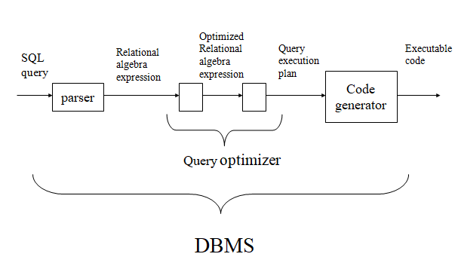
Query processing

Slide 40
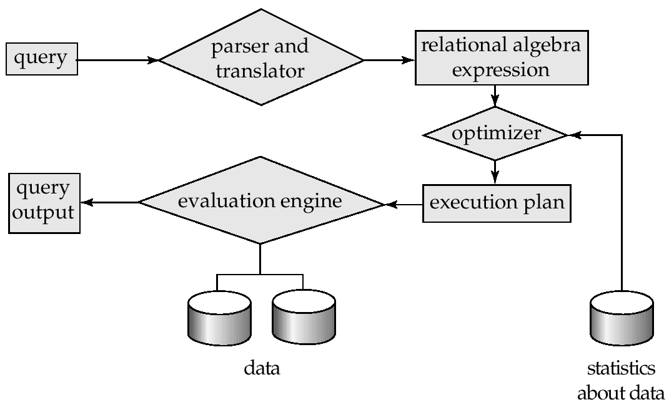
Query processing
Query Processing is the activity performed in extracting data from the database. In query processing, it takes various steps for fetching the data from the database. The steps involved are:
Parsing and translation
Optimization
Evaluation

Slide 41
Relational Query Languages
Relational query languages use relational algebra to break the user requests and instruct the DBMS to execute the requests.
It is the language by which user communicates with the database.
These relational query languages can be
Procedural Query Language
Non- Procedural Query Language

Slide 42
Conti……
Procedural Query Language
In procedural query language, user instructs the system to perform a series of operations to produce the desired results.
Here users tells what data to be retrieved from database and how to retrieve it. Relational algebra is a procedural query language.

Slide 43
Conti………….
2 Non- Procedural Query Language
In Non-procedural query language, user instructs the system to produce the desired result without telling the step by step process. Here users tells what data to be retrieved from database but doesn’t tell how to retrieve it. Relational Calculus is Non- Procedural Query Language.
Example :-
if you are just telling him to make a tea and not telling the process then it is a non-procedural language, however if you are telling the step by step process like switch on the stove, boil the water, add milk etc. then it is a procedural language.

Slide 44
Conti………….
Note :- I have used word conceptual while describing relational algebra and relational calculus, because they are theoretical mathematical system or query language, they are not the practical implementation, SQL is a practical implementation of relational algebra and relational calculus.

Slide 45
Relational Algebra
RELATIONAL ALGEBRA is a widely used procedural query language.
It collects instances of relations as input and gives occurrences of relations as output.
It uses various operations to perform this action. SQL Relational algebra query operations are performed recursively on a relation.
The output of these operations is a new relation, which might be formed from one or more input relations.

Slide 46
Relational Algebra Operations
Basic Operators
SELECT(σ)
Projection(π)
Rename (ρ)
Union operation (υ)
Set Difference (-)
Cartesian product(X)
Derived Operators
Intersection
Division
Join Operations
Inner Join:
Theta Join:
EQUI join:
NATURAL JOIN (⋈)
OUTER JOIN
Left Outer Join
Right Outer Join
Full Outer Join

Slide 47
Basic SQL Relational Algebra Operations
Relational Algebra divided in various groups
Unary Relational Operations
SELECT (symbol: σ)
PROJECT (symbol: π)
RENAME (symbol: ρ)
Relational Algebra Operations From Set Theory
UNION (υ)
INTERSECTION ( ),
DIFFERENCE (-)
CARTESIAN PRODUCT ( x )
Binary Relational Operations
JOIN
DIVISION

Slide 48
Basic SQL Relational Algebra Operations
Relational Algebra divided in various groups
Basic
SELECT (symbol: σ)
PROJECT (symbol: π)
RENAME (symbol: ρ)
UNION (υ)
DIFFERENCE (-)
CARTESIAN PRODUCT ( x )
Derived
JOIN
INTERSECTION ( )
DIVISION

Slide 49
Projection(π)
The projection eliminates all attributes of the input relation but those mentioned in the projection list. The projection method defines a relation that contains a vertical subset of Relation.
This helps to extract the values of specified attributes to eliminates duplicate values. (pi) symbol is used to choose attributes from a relation. This operator helps you to keep specific columns from a relation and discards the other columns.
π_{p}(r)
where:
π is the predicate
r stands for relation which is the name of the table
p is prepositional logic

Slide 50
Example of Projection
Consider the following table
Here, the projection of CustomerName and status will give
Π _{CustomerName, Status} (Customers)
CustomerID | CustomerName | Status
1 | Google | Active
2 | Amazon | Active
3 | Apple | Inactive
4 | Alibaba | Active
CustomerName | Status
Google | Active
Amazon | Active
Apple | Inactive
Alibaba | Active

Slide 51
SELECT (σ)
The SELECT operation is used for selecting a subset of the tuples according to a given selection condition. Sigma(σ)Symbol denotes it. It is used as an expression to choose tuples which meet the selection condition. Select operator selects tuples that satisfy a given predicate.
σ_{p}(r)
where:
σ is the predicate
r stands for relation which is the name of the table
p is prepositional logic

Slide 52
SELECT (σ) Examples
Example 1:
σ _{topic} = "Database" (Tutorials)
Output – Selects tuples from Tutorials where topic = ‘Database’.
Example 2
σ _{topic} = "Database" and author = “dbms"( Tutorials)
Output – Selects tuples from Tutorials where the topic is ‘Database’ and ‘author’ is dbms.
Example 3
σ _{sales} > 50000 (Customers)
Output – Selects tuples from Customers where sales is greater than 50000

Slide 53
Cartesian Product(X) in DBMS
Cartesian Product in DBMS is an operation used to merge columns from two relations. Generally, a cartesian product is never a meaningful operation when it performs alone. However, it becomes meaningful when it is followed by other operations. It is also called Cross Product or Cross Join.
σ _{column 2} = _{‘1’} (A X B)
Output – The above example shows all rows from relation A and B whose column 2 has value 1
σ column 2 = ‘1’ (A X B)
column 1 | column 2
1 | 1
1 | 1

Slide 54
Cartesian Product(X) Example
Consider R1 table −
Table R2
RegNo | Branch | Section
1 | CSE | A
2 | ECE | B
3 | CIVIL | A
4 | IT | B
Name | RegNo
Bhanu | 2
Priya | 4

Slide 55
Cartesian Product(X) Example
R1 X R2
RegNo | Branch | Section | Name | RegNo
1 | CSE | A | Bhanu | 2
1 | CSE | A | Priya | 4
2 | ECE | B | Bhanu | 2
2 | ECE | B | Priya | 4
3 | CIVIL | A | Bhanu | 2
3 | CIVIL | A | Priya | 4
4 | IT | B | Bhanu | 2
4 | IT | B | Priya | 4

Slide 56
Set Difference (-)
– Symbol denotes it. The result of A – B, is a relation which includes all tuples that are in A but not in B.
The attribute name of A has to match with the attribute name in B.
The two-operand relations A and B should be either compatible or Union compatible.
It should be defined relation consisting of the tuples that are in relation A, but not in B.

Slide 57
Set Difference (-) Example
Example: A-B
Table A – B
column 1 | column 2
1 | 2

Slide 58
Union operation (υ)
UNION is symbolized by ∪ symbol. It includes all tuples that are in tables A or in B. It also eliminates duplicate tuples. So, set A UNION set B would be expressed as:
The result <- A ∪ B
For a union operation to be valid, the following conditions must hold –
R and S must be the same number of attributes.
Attribute domains need to be compatible.
Duplicate tuples should be automatically removed.

Slide 59
Example of Union
Consider the following tables.
A ∪ B gives
Table A |  |  | Table B
column 1 | column 2 |  | column 1 | column 2
1 | 1 |  | 1 | 1
1 | 2 |  | 1 | 3
column 1 | column 2
1 | 1
1 | 2
1 | 3

Slide 60
Rename (ρ)
Rename is a unary operation used for renaming attributes of a relation.
ρ (a/b)R will rename the attribute ‘b’ of relation by ‘a’.

Slide 61
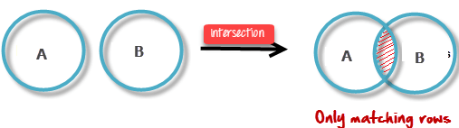
Intersection
An intersection is defined by the symbol ∩
A ∩ B
Defines a relation consisting of a set of all tuple that are in both A and B. However, A and B must be union-compatible.

Slide 62
Intersection Example
Example: A ∩ B
Table A ∩ B
column 1 | column 2
1 | 1

Slide 63
Join Operations
Join operation is essentially a cartesian product followed by a selection criterion.
Join operation denoted by ⋈.
JOIN operation also allows joining variously related tuples from different relations.
Types of JOIN: Various forms of join operation are:
Inner Joins:
Theta join
EQUI join
Natural join
Outer join:
Left Outer Join
Right Outer Join
Full Outer Join

Slide 64
Inner Join (Theta Join)
In an inner join, only those tuples that satisfy the matching criteria are included, while the rest are excluded. Let’s study various types of Inner Joins:
Theta Join:
The general case of JOIN operation is called a Theta join. It is denoted by symbol θ
Example:- A ⋈_{θ} B
Theta join can use any conditions in the selection criteria.
For example:- A ⋈ _{A.column 2 > B.column 2} (B)
A ⋈ A.column 2 > B.column 2 (B)
column 1 | column 2
1 | 2

Slide 65
Inner Join (Equi Join)
EQUI join:
When a theta join uses only equivalence condition, it becomes a equi join.
For example:- A ⋈ _{A.column 2 = B.column 2} (B)
A ⋈ A.column 2 = B.column 2 (B)
column 1 | column 2
1 | 1

Slide 66
Inner Join- Natural Join (⋈)
NATURAL JOIN does not utilize any of the comparison operators. In this type of join, the attributes should have the same name and domain.
In Natural Join, there should be at least one common attribute between two relations.
It performs selection forming equality on those attributes which appear in both relations and eliminates the duplicate attributes.

Slide 67
Natural Join Example
Consider the following two tables
C ⋈ D
C |  | D
Num | Square | Num | Cube
2 | 4 | 2 | 8
3 | 9 | 3 | 27
C ⋈ D
Num | Square | Cube
2 | 4 | 8
3 | 9 | 27

Slide 68
Outer Join
An OUTER JOIN doesn’t require each record in the two join tables to have a matching record. In this type of join, the table retains each record even if no other matching record exists.
Three types of Outer Joins are:
Left Outer Join
Right Outer Join
Full Outer Join

Slide 69
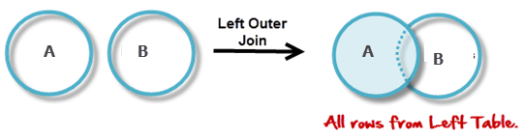
Left Outer Join (A B)
LEFT JOIN returns all the rows from the table on the left even if no matching rows have been found in the table on the right. When no matching record found in the table on the right, NULL is returned.

Slide 70
Consider the following 2 Tables
A
Num | Square
2 | 4
3 | 9
4 | 16
B
Num | Cube
2 | 8
3 | 27
5 | 125

Slide 71
(A B)
(A B)
Num | Square | Cube
2 | 4 | 8
3 | 9 | 27
4 | 16 | –

Slide 72
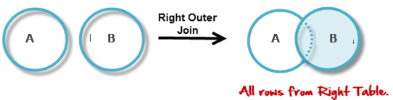
Right Outer Join (A B)
RIGHT JOIN returns all the columns from the table on the right even if no matching rows have been found in the table on the left. Where no matches have been found in the table on the left, NULL is returned. RIGHT outer JOIN is the opposite of LEFT JOIN

Slide 73
(A B)
(A B)
Num | Cube | Square
2 | 8 | 4
3 | 27 | 9
5 | 125 | –

Slide 74
Full Outer Join (A B)
In a FULL OUTER JOIN , all tuples from both relations are included in the result, irrespective of the matching condition.
Example:
A B
Num | Square | Cube
2 | 4 | 8
3 | 9 | 27
4 | 16 | –
5 | – | 125

Slide 75
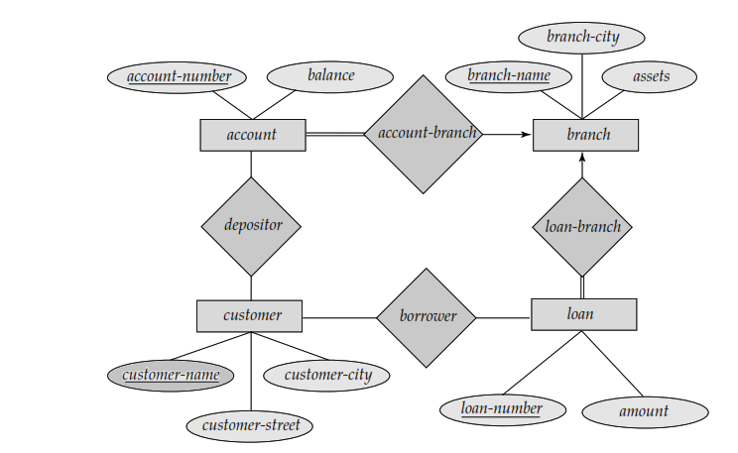
ER diagram for Banking Enterprises (CO1)

Slide 76
Schema Diagram For the Banking Enterprise
Branch
(branch_name, branch_city, assets)
Account
(account_number, balance, Branch_name)
Customer
(customer_name, customer_street, customer_city)
Loan
(loan_number, amount, Branch_name)
borrower
(customer_name, loan_number)
Depositor
(customer_name, account_number)

Slide 77
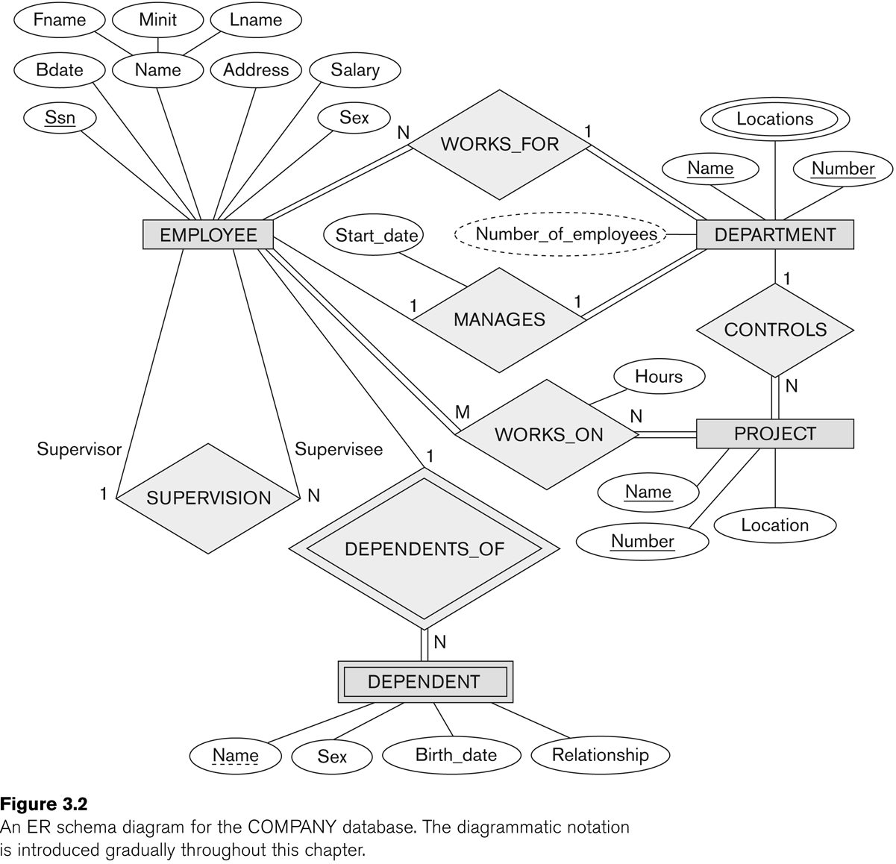
Diagram Company Database
ER Diagram for Company database

Slide 78
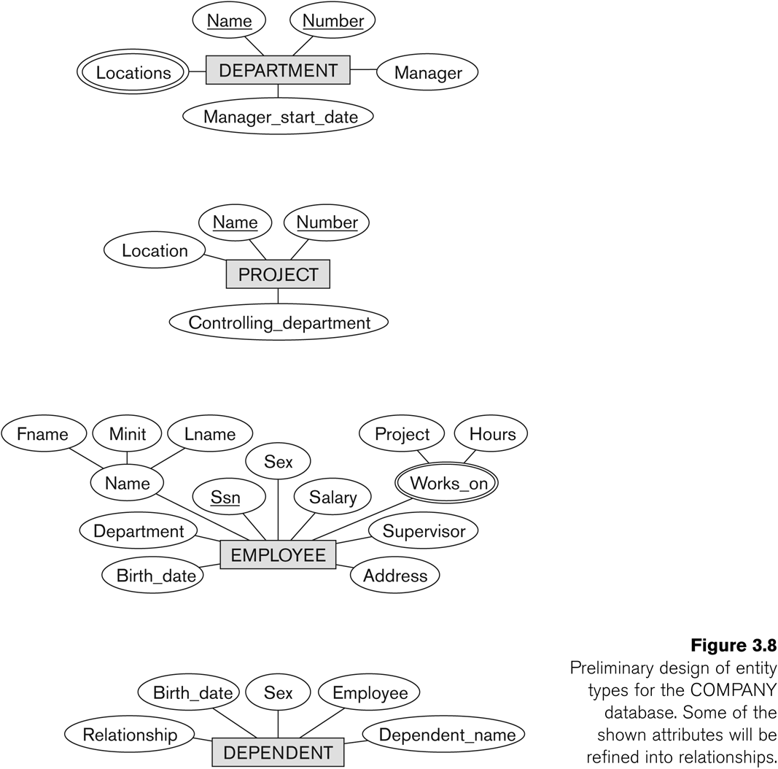

Slide 79
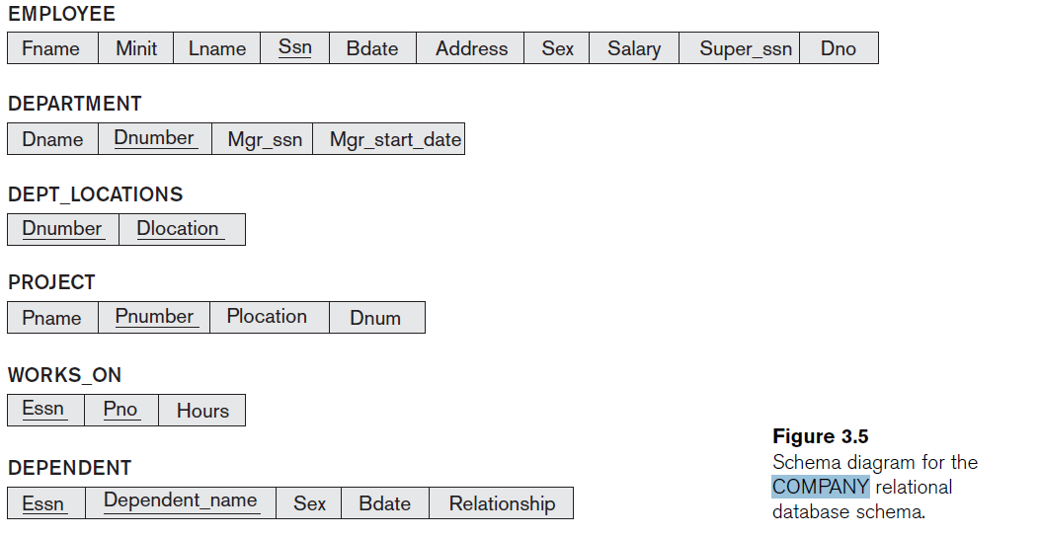
Schema Diagram For the Company Database

Slide 80
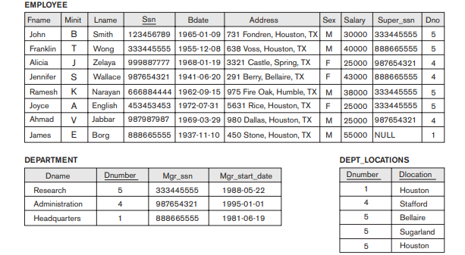
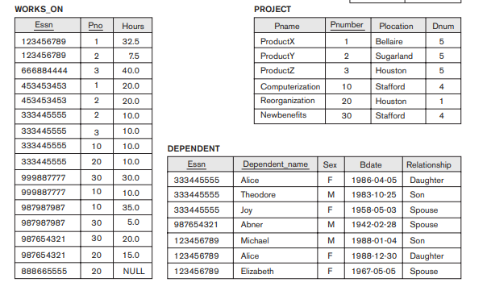
One possible database state for the COMPANY relational database schema

Slide 81
SELECT Operation(σ)
SELECT operation is used to select a subset of the tuples from a relation that satisfy a selection condition. It is a filter that keeps only those tuples that satisfy a qualifying condition – those satisfying the condition are selected while others are discarded.
The SELECT operation can also be visualized as a horizontal partition of the relation into two sets of tuples.—
Those tuples that satisfy the condition and are selected, and
Those tuples that do not satisfy the condition and are filtered out.

Slide 82
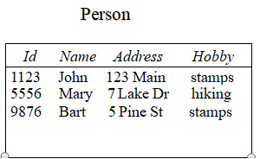


SELECT Operator
In general, the select operation is denoted by _{σ <selection condition>}(R) where the symbol σ (sigma) is used to denote the select operator, and the selection condition is a Boolean expression specified on the attributes of relation R.
Resulting relation has the same attributes as R
-Resulting relation includes each tuple in r(R) whose attribute values satisfy the condition ‘c’.
Relation :
Example :- Find all person hobby is ‘stamps’.
Ans: Output:-

Slide 83
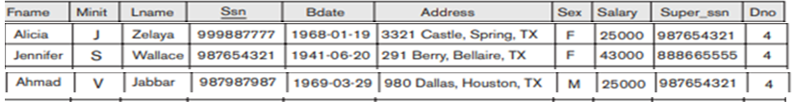
SELECT Operator
1:- Find all loans of over 12000.
Ans. σ_{amount > 12000} (loan)
2.To select the EMPLOYEE tuples whose department number is four or those whose salary is greater than 30,000.
we can individually specify each of these two conditions with a SELECT operation as follows: -
Ans. σ _{Dno=4} (Employee)
σ _{Salary> 30000}(Employee)
or
σ _{Dno=4 or Salary> 30000} (Employee)
Output

Slide 84
Select Operation
The Boolean expression specified in is made up of a number of clauses of the form
<Attribute-name ><comparison Op><constant value>
Or
<Attribute-name ><comparison Op><attribute name>
Where:
<Attribute-name > is the name of an attribute of R,
<comparison Op> is normally one of the operators {=,< , ≥,≠ }, and
<constant value> is a constant value from the attribute domain.

Slide 85
Select Operation
All the selected tuples appear in the result of the SELECT operation. The Boolean conditions AND, OR, and NOT have their normal interpretation, as follows: -
(cond1 AND cond2) is TRUE if both (cond1) and (cond2) are TRUE; otherwise, it is FALSE.
(cond1 OR cond2) is TRUE if either (cond1) or (cond2) or both are TRUE; otherwise, it is FALSE.
(NOT cond) is TRUE if cond is FALSE; otherwise, it is FALSE.
The SELECT operator is unary; that is, it is applied to a single relation. Moreover, the selection operation is applied to each tuple individually; hence, selection conditions cannot involve more than one tuple.

Slide 86
Select Operation
Clauses can be connected by the standard Boolean operators and, or, and not to form a general selection condition.
For example,
To select the tuples for all employees who either work in department 4 and make over 25,000 per year, or work in department 5 and make over 30,000.
we can specify the following SELECT operation:-
Ans.
Output

Slide 87
Select Operation
SELECT Operation Properties
The SELECT operation σ _{<selection condition>}(R) produces a relation S that has the same schema as R
The SELECT operation σ is commutative; i.e.,
σ _{<condition1>}(σ _{< condition2>} ( R)) = σ _{<condition2>} (σ _{< condition1>} ( R))
A cascaded SELECT operation may be applied in any order; i.e.,
σ _{<condition1>}(σ _{< condition2>} (σ _{<condition3>} ( R))
= σ _{<condition2>} (σ _{< condition3>} (σ _{< condition1>} ( R)))
A cascaded SELECT operation may be replaced by a single selection with a conjunction of all the conditions; i.e.,
σ _{<condition1>}(σ _{< condition2>} (σ _{<condition3>} ( R))
= σ <condition1> AND < condition2> AND < condition3> ( R)))

Slide 88
Select Operation with SQL
In SQL, the SELECT condition is typically specified in the WHERE clause of a query. For example, the following operation:
Example :- To select the tuples for all employees who work in department 4 and make over 30,000 per year.
Ans. σ Dno=4 AND Salary>30000 (EMPLOYEE)
Output
would correspond to the following SQL query: -
SELECT * FROM EMPLOYEE WHERE Dno=4 AND Salary>30000;

Slide 89
Quiz
Q1. What is Integrity Constraint? Also discussed the different type of Integrity Constraint?
Q2. Differentiate between relational data model, relational database and relation database management system.
Q3 Differentiate between procedural and non-procedural Query language .
Exercise:-
1. To find those tuple who live in the city “ Greater noida ” .
2. To find those tuple have loan of more than 2000 made by noida branch.

Slide 90
Project Operation (π) CO2
This operation selects certain columns from the table and discards the other columns. The PROJECT creates a vertical partitioning – one with the needed columns (attributes) containing results of the operation and other containing the discarded Columns.
The general form of the project operation is
π<attribute list>(R)
where π (pi) is the symbol used to represent the project operation and <attribute list> is the desired list of attributes from the attributes of relation R.
The project operation removes any duplicate tuples, so the result of the project operation is a set of tuples and hence a valid relation. This is also unary operator.

Slide 91
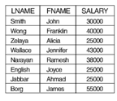
Projection Operator
Example 1;- To list each employee’s lastname, firstname and salary,
Ans
π _{LNAME,FNAME,SALARY}(EMPLOYEE)
Output

Slide 92
Projection Operator
Example 2:-To eliminate the branch_name attribute of account. ∏_{account_number, balance} (account)
Example 3:- Find the loan number for each loan of an amount greater than 12000.
Ans. ∏_{loan_number} (σ_{amount} _{> 12000} (loan))

Slide 93
Projection Operator
Exercise
To retrieve the firstname, lastname, and salary of all employees who work in department number 5.
π_{FNAME, LNAME, SALARY}(σ _{DNO=5}(EMPLOYEE))
2. To retrieve ssn all employees who work in departmentno=1.
π ssn(σ _{DNO=1}(EMPLOYEE))

Slide 94
Projection Operation
Rules of projection operator
The projection operation is performed after selection (if they are to be used together).
The degree of output relation (number of columns present) is equal to the number of attributes mentioned in the attribute list.
Projection operator does not obey commutative property
i.e. π _{<list2>} (π _{<list1>} (R)) ≠ π _{<list1>} (π _{<list2>} (R))
4. projection operation cascadeless because It may not be applied in any order.

Slide 95
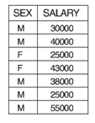
Projection Operation
Rules of projection operator
5. Project operation remove duplicate tuple from new relation
(If the attribute list includes only non key attributes of R, duplicate tuples are likely to occur. The PROJECT operation removes any duplicate tuples, (but is allowed in SQL) so the result of the PROJECT operation is a set of distinct tuples, and hence a valid relation. This is known as duplicate elimination.)
For example, consider the following PROJECT operation:-
Example :-Select the sex, salary from employee.
πSex, Salary(EMPLOYEE) Output
would correspond to the following Sql Query :-
Select distinct sex, salary from Employee;

Slide 96
Sequences of Operations and the RENAME Operation
We may want to apply several relational algebra operations one after the other. Either we can write the operations as a single relational algebra expression by nesting the operations, or we can apply one operation at a time and create intermediate result relations. In the latter case, we must give names to the relations that hold the intermediate results.
Example: To retrieve the first name, last name, and salary of all employees who work in department number 5, we must apply a select and a project operation.
We can write a single relational algebra expression In-line expression as follows:
π_{FNAME, LNAME, SALARY}(σ _{DNO=5}(EMPLOYEE))
Alternatively, we can explicitly show the sequence of operations,
DEP5_EMPS ← σ _{DNO=5}(EMPLOYEE)
RESULT ← π _{FNAME, LNAME, SALARY} (DEP5_EMPS)
We can explicitly show the sequence of operations, giving a name to each intermediate relation.

Slide 97
Rename Operation (ρ) CO2
The RENAME operation (ρ) is used to rename the output of a relation.
Sometimes it is simple and suitable to break a complicated sequence of operations and rename it as a relation with different names.
Reasons to rename a relation can be many, like –
We may want to save the result of a relational algebra expression as a relation so that we can use it later.
We may want to join a relation with itself, in that case, it becomes too confusing to specify which one of the tables we are talking about, in that case, we rename one of the tables and perform join operations on them.

Slide 98
Rename Operation (ρ)
The RENAME operator is denoted by ρ (rho)
The general RENAME operation ρ can be expressed by any of the following forms:-
ρ_{S (B1, B2, …, Bn )}(R) changes both:
the relation name to S, and
the column (attribute) names to B1, B1, …..Bn
ρ_{S}(R) changes:
the relation name only to S
ρ_{(B1, B2, …, Bn )}(R) changes:
the column (attribute) names only to B1, B1, …..Bn

Slide 99
Sequences of Operations and the RENAME Operation
Example :-
Relation
1. Department (Dno,Dname)
2. Project (Pno,Pname,Plocation)
1. Query to rename the attributes Dno, Dname of Relation Department to A,B.
ρ _{(A, B)} (Department)
2. Query to rename the Relation name Project to Pro and its attributes to P, Q, R.
ρ _{Pro(P, Q, R)} (Project)
3. Query to rename the Relation name Project to Project1.
ρ _{Project1} (project)

Slide 100
Rename Operation Example
Example:- To find the Fname,Lname,salary those employee who work in department number 5 with renaming of display attribute with Firstname,Lastname and salary.
Ans.
TEMP ← σDno=5(EMPLOYEE)
ρ(Firstname,Lastname,salary)←πFname, Lname, Salary(TEMP)
In SQL, a single query typically represents a complex relational algebra expression. Renaming in SQL is accomplished by aliasing using AS, as in the following example:
π_{FirstNAME, LastNAME, SALARY}(σ _{DNO=5}(EMPLOYEE))
SQl Query
SELECT F_name AS Firstname, L_name AS Lastname, salary AS salary FROM EMPLOYEE WHERE Dno=5;

Slide 101
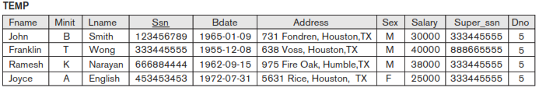
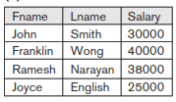

Continue
1. TEMP ← σDno=5(EMPLOYEE)
2. πFname,Lname, Salary(TEMP)
ρ(Firstname,Lastname,Salary)

Slide 102
Inline Expression
Example:- To find the Fname, Lname, salary those employee who work in department number 5 with renaming of display attribute with Firstname, Last name and salary.
π_{FirstNAME, LastNAME, SALARY}(σ _{DNO=5}(EMPLOYEE))
SQL Query
SELECT F_name AS Firstname, L_name AS Lastname, salary AS salary FROM EMPLOYEE WHERE Dno=5;

Slide 103
Binary Operator (SET THEORY)
Relational Algebra Operator
Binary Operator (SET THEORY)
union: ∪
Intersection:∩
set difference: –

Slide 104
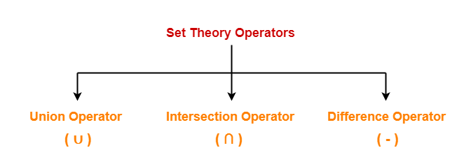
Relational Algebra Operators From Set Theory
The next group of relational algebra operations are the standard mathematical operations on sets. .These are binary operations; that is, each is applied to two sets (of tuples).
Condition For Using Set Theory Operators
To use set theory operators on two relations,
The two relations must be union compatible.
Union compatible property means-
Both the relations must have same number of attributes. (By default)
The attribute domains (types of values accepted by attributes) of both the relations must be compatible.
Note:-- Attribute name of both relation r and s are not affected union compatibility.

Slide 105
Type Compatibility
Type Compatibility
The operand relations R₁(A₁, A₂, ..., A_{n}) and R₂(B₁, B₂, ..., B_{n}) must have the same number of attributes, and the domains of corresponding attributes must be compatible; that is, dom(A_{i})=dom(B_{i}) for i=1, 2, ..., n.
The resulting relation for R₁∪R₂,R₁ ∩ R₂, or R₁-R₂ has the same attribute names as the first operand relation R1.(by convention).

Slide 106
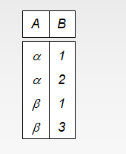
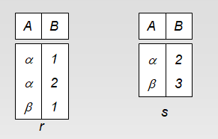
UNION Operation(∪)
UNION Operation
The result of this operation, denoted by R ∪ S, is a relation that includes all tuples that are either in R or in S or in both R and S.
Let R and S be two relations.
Then-
R ∪ S is the set of all tuples belonging to either R or S or both.
In R ∪ S, duplicates are automatically removed.
Example
r ∪ s

Slide 107

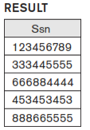
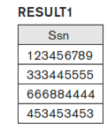

Conti…..
Example 1: To retrieve the social security numbers of all employees who either work in department 5 or directly supervise an employee who works in department 5.
DEP5_EMPS ← σ_{DNO=5} (EMPLOYEE)
RESULT1 ← π _{SSN}(DEP5_EMPS)
RESULT2(SSN) ← π _{SUPERSSN}(DEP5_EMPS)
RESULT ← RESULT1 ∪ RESULT2
Or
π _{SSN} ( σ_{DNO=5} (EMPLOYEE) ) ∪ π _{SUPERSSN} (σ_{DNO=5} (EMPLOYEE) )
RESULT1 ∪ RESULT2

Slide 108
UNION Operation(∪)
Sequence of Operation
DEP5_EMPS ← σ_{DNO=5} (EMPLOYEE)
RESULT1 ← π _{SSN}(DEP5_EMPS)
RESULT2(SSN) ← π _{SUPERSSN}(DEP5_EMPS)
RESULT ← RESULT1 ∪ RESULT2
SQL Query
Create table dep5_emps as select *from employee where dno=5;
Create table result1 from as select ssn from dep5_emps;
Create table result2 from as select superssn as ssn from dep5_emps;
Create table result as select * from result1 union select * from result2;

Slide 109
UNION Operation(∪)
In-Line Expression
π _{SSN} ( σ_{DNO=5} (EMPLOYEE) ) ∪ π _{SUPERSSN} (σ_{DNO=5} (EMPLOYEE) )
Sql Query
SELECT ssn from employee where dno=5 UNION SELECT superssn from employee where dno=5;

Slide 110
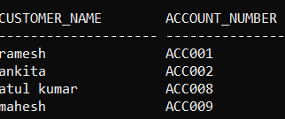
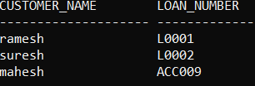
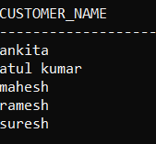
UNION Operation(∪)
Example 2 : To find all customers with either an account or a loan.
Depositor Borrower
ANS.
∏_{customer_name} (depositor) ∪ ∏_{customer_name} (borrower)
SQL Query
Select Cutomer_name from depositer union select Customer_name from borrower;

Slide 111
UNION Operation(∪)
Example 3 : To find all employees ssn who work either in department Number 5 or manage the department .
Ans ∏_{ssn} (σ_{DNO=5} (Employee) ) ∪ ∏_{mgr_ssn} ( σ_{DNumber=5} (Department))
Or
DEP5_EMPS ← σ_{DNunmber=5} (Department)
RESULT1(SSN) ← π _{MGR_SSN}(DEP5_EMPS)
DEP6_EMPS ← σ_{DNO=5} (EMPLOYEE)
RESULT2 ← π _{SSN}(DEP6_EMPS)
RESULT ← RESULT2 ∪ RESULT1
SQL Query
SELECT ssn from employee where dno=5 UNION SELECT mgr_ssn AS ssn from department where DNumber=5;

Slide 112


UNION Operation(∪)
DEP5_EMPS ← σ_{DNunmber=5} (Department)
RESULT1(SSN) ← π _{MGR_SSN}(DEP5_EMPS)
DEP6_EMPS ← σ_{DNO=5} (EMPLOYEE)
RESULT2 ← π _{SSN}(DEP6_EMPS)
RESULT ← RESULT2 ∪ RESULT1

Slide 113
Rules for set operations
Important Rule:-
The (union, intersection and minus) operator is used to combine the result-set of two or more SELECT statements.
The (union, intersection and minus) operator between two relations R and S produce output in new relation with name of attribute according first relation R.
The attribute must also have similar data types(domain type) in both relation R and S.
The columns in R relation SELECT statement must also be in the same order in another relation S. (equal)
In (union, intersection and minus) must have the same number of columns in both relations with same domain type order.(otherwise define the attribute name with select statement both relation R and S).

Slide 114

INTERSECTION OPERATION (∩)
INTERSECTION OPERATION
The result of this operation, denoted by R ∩ S, is a relation that includes all tuples that are in both R and S. The two operands must be "type compatible”.
Example
Let R and S be two relations.
Then-
R ∩ S is the set of all tuples belonging to both R and S.
In R ∩ S, duplicates are automatically removed.
R ∩ S

Slide 115
Example
Example 1:- To find all employees ssn who work in department Number 5 as well as they also manage department .
Ans
DEP5_EMPS ← σ_{DNunmber=5} (Department)
RESULT1(SSN) ← π _{MGR_SSN}(DEP5_EMPS)
DEP6_EMPS ← σ_{DNO=5} (EMPLOYEE)
RESULT2 ← π _{SSN}(DEP6_EMPS)
RESULT ← RESULT2 ∩ RESULT1
or
∏_{ssn}(σ_{DNO=5} (Employee) ) ∩ ∏_{mgr_ssn} ( σ_{DNumber=5} (Department))

Slide 116
Data Set

Slide 117

Intersection Operation(∩)
DEP5_EMPS ← σ_{DNunmber=5} (Department)
RESULT1(SSN) ← π _{MGR_SSN}(DEP5_EMPS)
DEP6_EMPS ← σ_{DNO=5} (EMPLOYEE)
RESULT2 ← π _{SSN}(DEP6_EMPS)
RESULT ← RESULT2 ∩ RESULT1

Slide 118
Example
SQL Query:-
SELECT ssn FROM employee where dno =5 INTERSECT SELECT mgr_ssn FROM department where dnumber=5;

Slide 119

Example
Example 1- Find all the customers who has an account in the bank as well as they have taken loan.
Ans
Π Customer_name(Depositor) ∩ Π Customer_name (Borrower)
SQL Query:-
SELECT Customer_name FROM Depositer INTERSECT SELECT Customer_name FROM Borrower;
Depositer Borrower

Slide 120
Properties of Union and Intersection
Properties of Union and Intersection
1. UNION and INTERSECTION are commutative operations; that is,
R ∪ S = S ∪ R and,
R ∩ S = S ∩ R
2. UNION and INTERSECTION can be treated as n-ary operations applicable to any number of relations because both are also associative operations; that is,
R ∪ (S ∪ T ) = (R ∪ S) ∪ T and,
(R ∩ S) ∩ T = R ∩ (S ∩ T )

Slide 121
Data Set

Slide 122
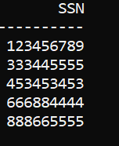
Example
Example :- To retrieve the social security numbers of all employees either who work in department 5 or directly supervise an employee who works in department 5 or also manage the department 5.
Ans
_{SSN}(σ_{DNO=5}(EMPLOYEE))∪π_{SUPERSSN}(σ_{DNO=5}(EMPLOYEE)) ∪ π _{Mgr_ssn} (σ_{DNumber=5} (Department) )
SQL Query
select ssn from employee where dno=5 union select superssn from employee where dno=5 union select mgr_ssn from department where Dnumber=5;

Slide 123
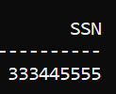
Example
Example:- To retrieve the social security numbers of all employees who work in department 5 and directly supervise an employee who works in department 5 as well as they also manage the department.
Ans.
∏ssn(σ_{DNO=5}(Employee))∩∏mgr_ssn( σ_{DNumber=5} (Department)) ∩ ∏superssn ( σ_{DNO=5} (Employee))
SQL Query
select ssn from employee where dno=5 intersect select mgr_ssn from department where dnumber=5 intersect select superssn from employee where Dno=5;

Slide 124
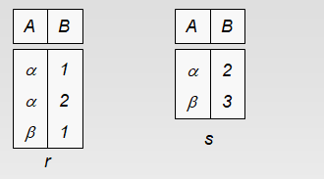
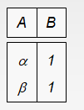
Set Difference (or MINUS or Except) Operation
The result of this operation, denoted by R - S, is a relation that includes all tuples that are in R but not in S. The two operands must be "type compatible”.
Let R and S be two relations.
Then-
R − S is the set of all tuples belonging in R but not in S.
In R −S, duplicates are automatically removed.
Example:-
r-s

Slide 125

Set Difference (or MINUS or Except) Operation
Example :- Find all the customers who has an account in the bank but not make loan.
Ans
Π Customer_name(Depositor) - Π Customer_name (Borrower)
SQL Query:-
SELECT Customer_name FROM Depositer minus SELECT Customer_name FROM Borrower;
Depositer Borrower

Slide 126
Data Set

Slide 127

Example
Example :To retrieve the social security numbers of all employees who work as supervisor but not as a manager.
Ans.
∏superssn(Employee) - ∏mgr_ssn(Department)
SQL Query
select superssn from employee minus select mgr_ssn from department ;

Slide 128
More Example
STUDENT
INSTRUCTOR
STUDENT ∪ INSTRUCTOR
Fn | Ln
Susan | Yao
Ramesh | Shah
Johnny | Kohler
Barbara | Jones
Amy | Ford
Jimmy | Wang
Ernest | Gilbert
Fname | Lname
John | Smith
Ricardo | Browne
Susan | Yao
Francis | Johnson
Ramesh | Shah
Fn | Ln
Susan | Yao
Ramesh | Shah
Johnny | Kohler
Barbara | Jones
Amy | Ford
Jimmy | Wang
Ernest | Gilbert
John | Smith
Ricardo | Browne
Francis | Johnson
STUDENT ∩ INSTRUCTOR
STUDENT – INSTRUCTOR
Fn | Ln
Susan | Yao
Ramesh | Shah
Fn | Ln
Johnny | Kohler
Barbara | Jones
Amy | Ford
Jimmy | Wang
Ernest | Gilbert
INSTRUCTOR – STUDENT
Fname | Lname
John | Smith
Ricardo | Browne
Francis | Johnson

Slide 129
Binary Operator
Relational Algebra Operator
Binary Operator
Cartesian Product or Cross Product(X)
Join
division (÷)

Slide 130
CARTESIAN (or cross product) Operation
The Cartesian Product is also an operator which works on two sets. It is sometimes called the CROSS PRODUCT or CROSS JOIN.
Cartesian Product or CROSS PRODUCT or CROSS JOIN is denoted by x, it is also binary set operation.
The relation on which it is applied do not have to be union compatibility.
Cartesian Product in DBMS is an operation used to merge columns from two relations. This operation is used to combine tuples from two relations in a conjunctional fashion.

Slide 131
Important points on CARTESIAN PRODUCT(CROSS PRODUCT) Operation
In general, the result of R x S
The cardinality (number of tuples) of resulting relation from a Cross Product operation is equal to the number of attributes(say m) in the first relation multiplied by the number of attributes in the second relation(say n).
Cardinality = m*n
The Cross Product of two relation A(R1, R2, R3, …, Rp) with degree p, and B(S1, S2, S3, …, Sn) with degree n, is a relation C(R1, R2, R3, …, Rp, S1, S2, S3, …, Sn) with degree p + n attributes.
Degree = p+n
In SQL, CARTESIAN PRODUCT(CROSS PRODUCT) can be applied using CROSS JOIN.

Slide 132
Important points on CARTESIAN PRODUCT(CROSS PRODUCT) Operation
In general, we don’t use Cartesian Product unnecessarily, which means without proper meaning we don’t use Cartesian Product. Generally, we use Cartesian Product followed by a Selection operation and comparison on the operators as shown below :
σ _{A=D} (A ✕ B)
The above query gives meaningful results.
CROSS PRODUCT is a binary set operation means, at a time we can apply the operation on two relations.
But the two relations on which we are performing the operations do not have the same type of tuples, which means Union compatibility (or Type compatibility) of the two relations is not necessary.

Slide 133
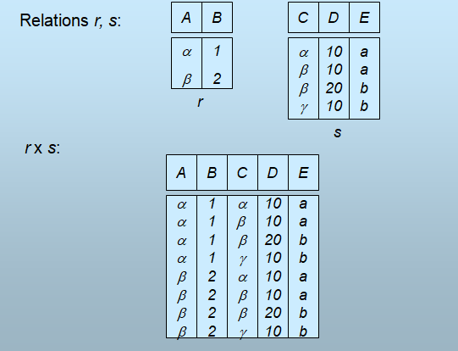
Example

Slide 134
One possible database state for the COMPANY relational database schema

Slide 135
Example
Example :- We want to retrieve a list of names of each female employee’s dependents.
Relational Algebra Query :-
FEMALE_EMPS ← σ _{SEX=’F’}(EMPLOYEE)
EMPNAMES ← π _{FNAME, LNAME, SSN} (FEMALE_EMPS)
EMP_DEPENDENTS ← EMPNAMES x DEPENDENT
ACTUAL_DEPENDENTS ← σSsn=Essn(EMP_DEPENDENTS)
RESULT ← πFname, Lname,Dependent_name(ACTUAL_DEPENDENTS)

Slide 136
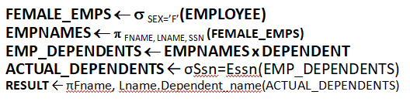
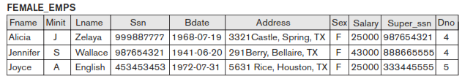
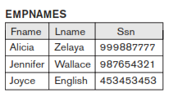
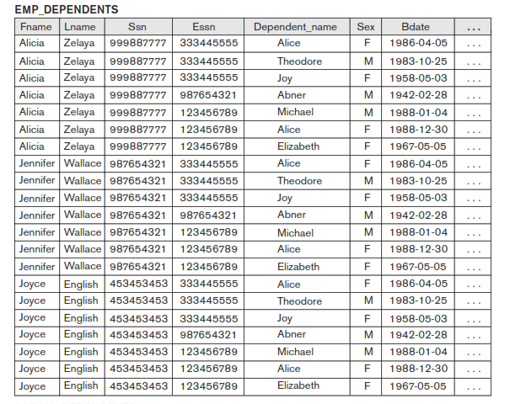


Sequence of operation

Slide 137
Continue
Example :- We want to retrieve a list of names of each female employee’s dependents.
Relational Algebra Query (inline):-
π Fname, Lname, Dependent_name(σ ssn=Essn (π _{FNAME, LNAME, SSN} ( σ _{SEX=’F’}(EMPLOYEE)) x DEPENDENT))
SQL Query:-
Select Fname,Lname, Dependent_name from employee cross join dependent where ssn=essn and employee.sex=‘F’;

Slide 138
Schema Diagram For the Banking Enterprise
Branch
(branch_name, branch_city, assets)
Account
(account_number, balance, Branch_name)
Customer
(customer_name, customer_street, customer_city)
Loan
(loan_number, amount, Branch_name)
borrower
(customer_name, loan_number)
Depositor
(customer_name, account_number)

Slide 139
Example (CO2)
Example 2:- To find the customer name of all customer who have a loan at Greater Noida branch.
Relational Algebra Query
πcustomer_name(σborrower.loan_no=Loan.loan_no(π _{Loan_no}( σ _{branch_name=’Greater Noida’} (loan ))x borrower))
Or
_{Customer_name} (σ _{branch_name=“Greater Noida”} (σ borrower.loan_no = loan.loan_no(borrower x loan)))
Or
π_{Customer_name} (σ_{branch_name=“GreaterNoida” and} _{borrower.loan_no= loan.loan_no}(borrower x loan))
SQL Query :-
Select customer_name from borrower cross join loan where loan.loan_no=borrower.loan_no and branch_name =‘Greater Noida’;

Slide 140
Example (CO2)
Example3:- - Find the names of all customers who have a loan at the Noida branch but do not have an account at any branchof the bank.
Relational Algebra Query
_{customer-name} (σ _{branch_name=“Noida”} (σ borrower.loan_number = loan.loan_number(borrower x loan))) - π _{customer-name}(depositor)

Slide 141
Continue (CO2)
Note :- The CARTESIAN PRODUCT operation applied by itself is generally meaningless. It is mostly useful when followed by a selection that matches values of attributes coming from the component relations.
Cross Join does not itself apply any predicate to filter tuples from the joined tables. The result of a cross join can be filtered by using a where clause, which may be the produce the equivalent inner join.

Slide 142
Join and Types of Join

Slide 143
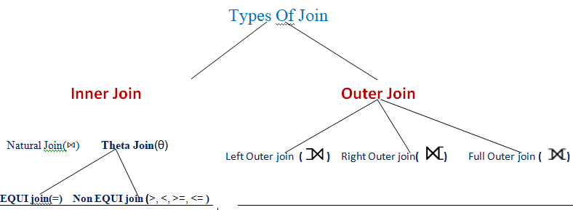
Content
Relational Algebra Operator
Join & Types of Join

Slide 144
Join
In previous we understand the benefit of cross product of two relations which gives us all the possible, tuples that are paired together.
But it might be feasible that in certain cases to take a Cartesian product where we encounter huge relations with thousand tuples having a considerable large number of attribute.
So join is a combination of a Cartesian product followed by a selection process. A join operation pairs two tuples from different relation, if and only if a given join condition is satisfied.
It is denoted by

Slide 145
Join definition (CO2)
A special operation, called JOIN combines this sequence into a single operation.
This operation is very important for any relational database with more than a single relation, because it allows us combine related tuples from various relations.
The general form of a join operation on two relations
R(A1, A2, . . ., An) and S(B1, B2, . . ., Bm) is:
R _{<join condition>}S
where R and S can be any relations that result from general relational algebra expressions. The result of the JOIN is a relation Q with n + m attributes Q(A1, A2, … , An, B1, B2,… , Bm) in that order;
Q has one tuple for each combination of tuples—one from R and one from S—whenever the combination satisfies the join condition.

Slide 146
Join working Rules
The join condition is specified on attributes from the two relations R and S and is evaluated for each combination of tuples. Each tuple combination for which the join condition evaluates to TRUE is included in the resulting relation Q as a single combined tuple.
Tuples whose join attributes are NULL or for which the join condition is FALSE do not appear in the result. In that sense, the JOIN operation does not necessarily preserve all of the information in the participating relations, because tuples that do not get combined with matching ones in the other relation do not appear in the result.

Slide 147
Cont…….
The main difference between CARTESIAN PRODUCT and JOIN.
In JOIN, only combinations of tuples satisfying the join condition appear in the result, whereas in the CARTESIAN PRODUCT all combinations of tuples are included in the result.

Slide 148
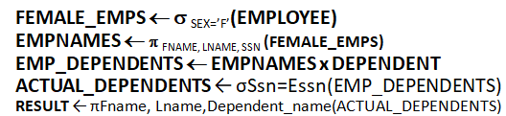
Example
Example :- we want to retrieve a list of names of each female employee’s dependents.
Relational Algebra Query :-
FEMALE_EMPS ← σ _{SEX=’F’}(EMPLOYEE)
EMPNAMES ← π _{FNAME, LNAME, SSN} (FEMALE_EMPS)
ACTUAL_DEPENDENTS ← EMPNAMES Ssn=Essn DEPENDENT
RESULT ← πFname, Lname, Dependent_name(ACTUAL_DEPENDENTS)
Here
EMP_DEPENDENTS ← EMPNAMES × DEPENDENT
ACTUAL_DEPENDENTS ← σSsn=Essn(EMP_DEPENDENTS)
These two operations can be replaced with a single JOIN operation as follows:-
ACTUAL_DEPENDENTS ← EMPNAMES Ssn=EssnDEPENDENT

Slide 149
Conti……
Example :- we want to retrieve a list of names of each female employee’s dependents.
π Fname, Lname, Dependent_name(DEPENDENT Ssn=Essn (π _{FNAME, LNAME, SSN} ( σ _{SEX=’F’}(EMPLOYEE)))
SQL Query
Select Fname,Lname, Dependent_name from employee inner join dependent on ssn=essn and employee.sex=‘F’;

Slide 150
Content
Relational Algebra Operator
Join & Types of Join

Slide 151
Inner Join
The INNER JOIN creates a new result Q by combining column values of two Relation (R and S) based upon the join-predicate. The query compares each row of R with each row of S to find all pairs of rows which satisfy the join-predicate. When the join-predicate is satisfied, column values for each matched pair of rows of A and B are combined into a result row.
Types of Inner Join are
Natural join
Theta join
A. Equi join
B. Non –Equi Join

Slide 152
Inner Join
Natural Join :- Natural join does not use any comparison operator. We can perform a natural join only if there is at least one common attribute that exists between relation R and S.
In addition, the attribute must have same domain type and same name .
Natural Join joins two tables based on same attribute name and The resulting table will contain all the attributes of both the tables but only one copy of each common column.
In general natural join denoted by
Example
R = (A, B, C, D)
S = (E, B, D)
Result schema = (A, B, C, D, E)
Note :- if two relation do not have same name attribute in both relation such case rename the attribute name corresponding to another relation otherwise we got the Cartesian product of Natural Join.

Slide 153
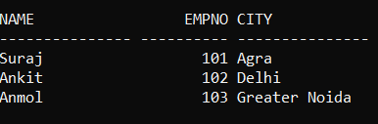

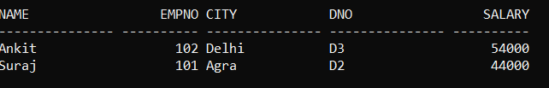
Example
Emp1 Dep1
Relation Algebra Query
Emp1 Dep1
SQL Query
Select * from Emp1 natural join Dep1;
Output

Slide 154
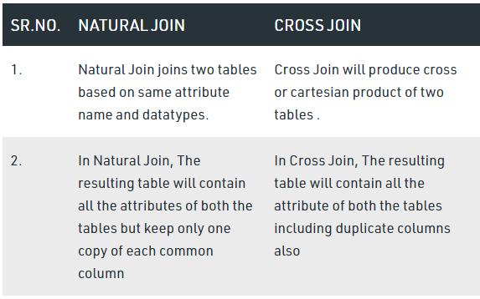
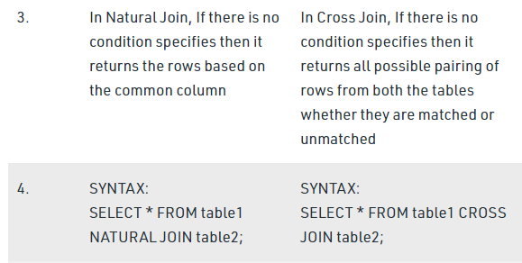
Difference between Natural JOIN and CROSS JOIN in SQL

Slide 155
Inner Join
Theta Join (θ):- Theta join combines those tuples from different relations they satisfy the θ condition.
Theta join is denoted by
R1 R2
Where R1 and R2 are relations having attribute (A1,A2,….An) and (B1,B2,…..Bn) ,
Ai θ Bj, Ai is an attribute of R1, Bj is an attribute of R2, Ai and Bj have the same domain, and θ (theta) is one of the comparison operators {=,< ,>, ≥, ≠ }.
θ

Slide 156
Inner Join
There are two of Theta Join(θ)
Equi Join (=)
Non Equi Join (< ,>, ≥, ≠ )

Slide 157
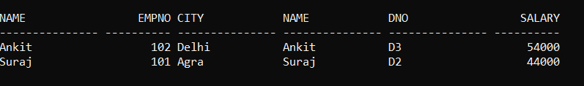
Inner Join
Equi Join :- When theta join use only equality comparison operator is called equi Join .
Example :-
Relational algebra Query
Emp1 emp1.name=dep1.name(Dep1)
Here θ (emp1.name=dep1.name)
SQL Query
Select * from emp1 inner join dep1 on emp1.name=dep1.name;

Slide 158

Example
Example 1:- we want to retrieve the name of the manager of each department.
Relational Algebra Query :-
To get the manager’s name, we need to combine each department tuple with the employee tuple whose Ssn value matches the Mgr_ssn value in the department tuple.
Sql Query
Select Mgr_ssn from department inner join employee on mgr_ssn=ssn;

Slide 159
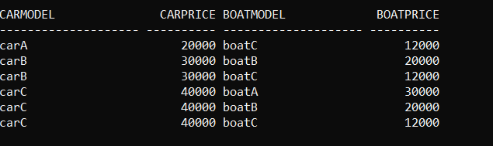
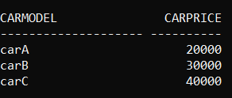

Inner Join
2. Non Equi Join:- Non Equi join is an inner join that uses an unequal operation like as (< ,>, ≥, ≠,between etc ) to match rows from different relations.
Example :- A customer wants to buy a car and a boat, but he/ she does not want to spend more money for the boat than for the car.
Car Boat
Query:- car ⋈carprice>boatprice Boat
Sql Query :- Select * from car inner join boat on carprice>boatprice;

Slide 160
Difference between Natural join and Inner Join in SQL
Natural Join :
Natural Join joins two tables based on same attribute name and datatypes. The resulting table will contain all the attributes of both the table but keep only one copy of each common column.
Inner Join :
Inner Join joins two table on the basis of the column which is explicitly specified in the ON clause. The resulting table will contain all the attributes from both the tables including common column also.

Slide 161

Difference between Natural join and Inner Join in SQL

Slide 162
Outer Join
A set of operation, called outer join can be used when we want to keep all the tuples in R, or all those in S, or all those in both relation in the result of the join, regardless of whether or not they have matching tuples in other relation.
The outer join operation is an extension of the inner join operation where the result includes all the tuples in one relation even when some of these have no matching tuples on the second relation.
Whereas the result of inner join consist of tuples formed by combining matching tuples in two operands.

Slide 163
Need of Outer Join
Since the scheme of the result includes all attributes from both relations, whenever a tuple from the first relation has no matching tuple in the second relation, the result will have a tuple with NULLs on the attributes of the second relation.
This satisfies the need of queries in which tuple from two relation are to be combined by matching corresponding rows, but without loosing any tuple for lack of matching values.

Slide 164
Types of Outer Join (CO2)
Types of Outer join
1 Left Outer join ( )
2 Right Outer Join () ) )
3 Full Outer join ( )
1. Left Outer Join ( ) :- Takes all tuples in the left relation that did not match with any right relation, pads the tuple with null values for all other attributes from the right relation and adds then to the result of natural join.

Slide 165


Left outer join Example
Example
EMP Dept
Relational Algebra Query:- Emp (emp.empid=dept.empid) Dept
Sql Query:- select * from emp left outer join dept on emp.empid = dept.emp_id;

Slide 166
Left outer join Example
OUTPUT
EMPID | EMP_NAME | ADDRESS | EMP_ID | SALARY | AGE
1 | Abhay | Noida | 1 | 30000 | 18
2 | Saurabh | Delhi | 2 | 40000 | 20
3 | Suresh | Gr Noida | - | - | -

Slide 167
Right Outer Join
Right Outer Join ( ): - Takes all tuples in the right relation that did not match with any left relation, pads the tuple with null values for all other attributes from the left relation and adds then to the result of natural join.
Example :-
Emp Dept
Relational Algebra Query :- Emp (emp.empid=dept.empid) Dept
Sql Query :- Select * from emp right outer join dept on emp.empid=dept.emp_id;

Slide 168
Right outer join Example
OUTPUT
EMPID | EMP_NAME | ADDRESS | EMP_ID | SALARY | AGE
1 | Abhay | Noida | 1 | 30000 | 18
2 | Saurabh | Delhi | 2 | 40000 | 20
- | -- | - | 4 | 20000 | 28
- | - | - | 6 | 18000 | 40

Slide 169
Full Outer Join
Full Outer Join ( ):- All the tuples from both participating relations are included in the resulting relation. If there no matching tuples for both relation their respective unmatched attribute made null.
Example:-
Emp Dept
Relational Algebra Query :- Emp (emp.empid=dept.emp_id) Dept
SQL Query:- select * from emp full outer join dept on emp.empid=dept.emp_id

Slide 170
Right outer join Example
OUTPUT
EMPID | EMP_NAME | ADDRESS | EMP_ID | SALARY | AGE
1 | Abhay | Noida | 1 | 30000 | 18
2 | Saurabh | Delhi | 2 | 40000 | 20
3 | Suresh | Gr Noida | - | - | -
- | - | - | 4 | 20000 | 28
- | - | - | 6 | 18000 | 40

Slide 171
Division (÷) (CO2)
The division is a binary operation that is written as R ÷ S.
Given two relations(tables): R(x,y) , S(y). R and S : tables x and y : column of R y : column of S
R(x,y) ÷ S(y) means gives all distinct values of x from R that are associated with all values of y in S.
The division operator is used when we have to evaluate queries which contain the keyword ALL.
The division operation is used to condition where a given relation R is to be split based on its association with every tuple in another relation S.

Slide 172



Example (CO2)
Example :- To find the rollno of students who issue every book.
Studentt Book
Relational Algebra Query :- π _{Roll_no,Bookname}(Studentt) ÷ π_{Bookname}(Book)
Output

Slide 173
Division (÷) (CO2)
Interpretation of R÷S are:-
All possible combinations
r1 ← π_{x}(R) x S
x values with “incomplete combinations”,
r2x ← πx(r1-R) and
result ← πx(R)-r2
or
x R ÷ S = πx(R)- πx((πx(R) x S) – R)

Slide 174




Divison (÷) (CO2)
Step1 :- r1 ← (πrollno(studentt) x book)
πrollno(studentt) book r1
x =
Step2:- r2rollno ← πrollno(r1-studentt) r1 Studentt r2
_ =
Step3:- result ← πrollno(studentt)-r2 πrollno(studentt) r2 result _ =

Slide 175
Division (÷) (CO2)
Sequence of Operation Query
All possible combinations
r1 ← πrollno(Studentt) x Book
x values with “incomplete combinations”,
r2rollno ← πrollno(r1-studentt) and
result ← πrollno(studentt)-r2
or
πrollno(Student)- πrollno((πrollno(studentt) x book) – Studentt)

Slide 176

Recap of Relational Algebra Operations

Slide 177
Content
Lecture 9:- Extended Operator
Assignment ←
Generalized projection operation
Aggregate Functions
Insert, delete and update operations

Slide 178
Assignment Operation
The assignment operation (←) provides a convenient way to express complex queries.
Write query as a sequential program consisting of
a series of assignments followed by an expression whose value is displayed as a result of the query.
Assignment must always be made to a temporary relation variable.
Example: Write r ÷ s as
temp1 ← ∏_{R-S} (r) temp2 ← ∏_{R-S} ((temp1 x s) – ∏_{R-S,S} (r)) result ← temp1 – temp2
The result to the right of the ← is assigned to the relation variable on the left of the ←.
May use variable in subsequent expressions.

Slide 179
Generalized projection operation
Generalized Projection
The GENERALIZED PROJECTION operation is an extension to the PROJECTION operation. In this case, arithmetic functions can be used in the projection list on certain attributes.
The general form of generalized projection:- ∏ _{F1, F2, …, Fn}(R)
Where R is a Relation Algebra Expression, where F1, F2, … , Fn are functions over the attributes in relation R and may involve arithmetic operations and constant values.
This operation is helpful when developing reports where computed values have to be produced in the columns of a query result

Slide 180

Generalized projection operation Example
Example
Suppose given a relation credit-_acct(customer-name, limit, credit-balance)
find how much more each person can spend: -
Query :-

Slide 181
Aggregate Functions and Operations
Aggregation function:- An aggregate function operates on a set of values (tuples) and computes one single value as output
Aggregate operation in relational algebra
G1, G2, …, Gn F1 ( A1), F2( A2),…, Fn( An) (E)
E is any relational-algebra expression
G₁, G₂ …, G_{n} is a list of attributes on which to group (can be empty)
Each F_{i} is an aggregate function
Each A_{i} is an attribute name

Slide 182
Aggregate Functions and Operations
There are five types of aggregate function
The Set Functions in Relational Algebra
sum(): computes the sum of all values in the (numeric) set
avg(): computes the average of all values in the (numeric) set
max(): finds the maximum value of all values in the set
min(): finds the minimum value of all values in the set
count(): returns the cardinaility (number of elements) in the set.
Note: count just counts the number of rows, without removing duplicates
COUNT(*) takes no parameters and does not support the use of DISTINCT. COUNT(*) returns the number of rows in a specified table, and it preserves duplicate rows. It counts each row separately. This includes rows that contain null values.

Slide 183

Example
To retrieve the sum of salaries all branches.
sum(salary) Employee
To retrieve the sum of salary, min salary of all branches.
sum(salary),min(salary) Employee

Slide 184
Conti.. (CO2)
Result of Aggregate function do not eliminate
–so distinct to any aggregate function to specify elimination of duplicates
Result of aggregation does not have a name
Can use rename operation to give it a name
For convenience, we permit renaming as part of aggregate operation
Example
_{sum(salary) as sum-balance} (Employee)

Slide 185


Conti.. (CO2)
“Find the maximum available credit of any account.”
SQL Query :
Select max available_credit, (limit –balance) as available_credit from credit_acct.

Slide 186



Grouping and Aggregation
The GROUP BY Statement in SQL is used to arrange identical data into groups with the help of some functions .i.e if a particular column has same values in different rows then it will arrange these rows in a group.
For example:-
Query :- “How many puzzles has each person completed?”
First, input relation completed is grouped by unique values of person_name
Then, count(puzzle_name) is applied separately to each group

Slide 187

Grouping and Aggregation

Slide 188
Conti….
Important Points:
GROUP BY clause is used with the SELECT statement.
In the query, GROUP BY clause is placed after the WHERE clause.
In the query, GROUP BY clause is placed before ORDER BY clause if used any.
Syntax:-
SELECT column1, function_name(column2)
FROM table_name
WHERE condition
GROUP BY column1, column2
ORDER BY column1, column2;
function_name: Name of the function used for example, SUM() , AVG().
table_name: Name of the table.
condition: Condition used.
.

Slide 189


Conti….
Example 2:- Find the average salary of employee each department.
Sql Query :- select depno,avg(salary ) from a_department group by depno;
Note:- Group functions require that any column listed in the SELECT clause that is not the part of a group function must be listed in a GROUP by clause

Slide 190

Conti….
Example 3:- Find the average salary of employee each department where each department average salary greater then 40000.
Sql Query :- select depno,avg(salary ) from a_department where salary > 40000 group by depno;

Slide 191
Conti….
Having clause
Having clause works with a group by clause but specifically works on aggregate function condition.
ORDER BY clause
Order By clause shows the records in ascending or descending order of the specific condition.
.

Slide 192

Conti….
Example 3:- we want to find average salary of employee each department, but only for those department which have more than three employee’s.
Sql Query :- select depno,avg(salary ) from a_department where count(*) > 3 group by depno; (Error)
select depno,avg(salary ) from a_department group by depno having count(*) > 3;

Slide 193

Conti….
Example 3:- we want to find average salary of employee each department, but only for those department which have more than 2 employee’s in a order.
select depno,Max(salary ) from a_department group by depno having count(*) > 3 order by desc ;

Slide 194
Conti….
Where Clause to restrict the rows that you selected ,we can use the HAVING clause to restrict groups.
In a query using a GROUP BY and HAVING clause, the rows are first grouped, group function are applied, and then only those groups matching the having clause are displayed.
The WHERE clause is used to restrict rows;the HAVING clause is used to restrict group return from a GROUP BY clause.

Slide 195
Modification of the Database
The content of the database may be modified using the following operations:
Deletion
Insertion
Updating
All these operations are expressed using the assignment operator.

Slide 196
Deletion
A delete request is expressed similarly to a query, except instead of displaying tuples to the user, the selected tuples are removed from the database.
Can delete only whole tuples; cannot delete values on only particular attributes
A deletion is expressed in relational algebra by:
r ← r – E
where r is a relation and E is a relational algebra query.

Slide 197
Examples
Delete all account records in the Greater Noida branch.
account ← account – σ _{branch-name = “Greater noida”} (account)
2. Delete all loan records with amount in the range of 0 to 50
loan ← loan – σ _{amount ≥ 0 and amount ≤ 50} (loan)

Slide 198
Insertion
To insert data into a relation, we either:
specify a tuple to be inserted
write a query whose result is a set of tuples to be inserted
In relational algebra, an insertion is expressed by:
r ← r ∪ E
where r is a relation and E is a relational algebra expression.
The insertion of a single tuple is expressed by letting E be a constant relation containing one tuple.

Slide 199
Example
Examples:- Insert information in the database specifying that Smith has $1200 in account A-973 at the Greater Noida branch.
account ← account ∪ {(“Greater Noida”, A-973, 1200)}
depositor ← depositor ∪ {(“Smith”, A-973)}

Slide 200
Updating
A mechanism to change a value in a tuple without charging all values in the tuple
Use the generalized projection operator to do this task
r ← ∏ _{F1, F2, …, FI,} (r)
Each F_{i} is either,
the ith attribute of r, if the ith attribute is not updated, or,
if the attribute is to be updated F_{i} is an expression, involving only constants and the attributes of r, which gives the new value for the attribute
Update Condition wise :- r ← ∏ _{F1, F2, …, FI,} (σp(r)) ∪ (r-σp(r))

Slide 201
Example
Example :- Make interest payments by increasing all balances by 5 percent.
account ← ∏ _{AN, BN, BAL * 1.05} (account)
where AN, BN and BAL stand for account-number, branch-name and balance, respectively.
Example :- All account with balance over 10,000 receive 7% interest, whereas all others receive the 65 interest.
∏ _{AN, BN, BAL * 1.07} (σ bal >10000 (account)) ∪ ∏ _{AN, BN, BAL * 1.06} (σ bal <10000 (account))

Slide 202
Relational Algebra
Procedural language
Six basic operators
select: σ
project: ∏
union: ∪
set difference: –
Cartesian product: x
rename: ρ
The operators take one or two relations as inputs and produce a new relation as a result.

Slide 203
Select Operation
Notation: σ _{p}(r)
p is called the selection predicate
Defined as: σ_{p}(r) = {t | t ∈ r and p(t)}
Where p is a formula in propositional calculus consisting of terms connected by : ∧ (and), ∨ (or), ¬ (not) Each term is one of:
<attribute> op <attribute> or <constant>
where op is one of: =, ≠, >, ≥. <. ≤
Example of selection: σ _{dept_name=“Physics”}(instructor)

Slide 204
Project Operation
Notation:
where A₁, A₂ are attribute names and r is a relation name.
The result is defined as the relation of k columns obtained by erasing the columns that are not listed
Duplicate rows removed from result, since relations are sets
Example: To eliminate the dept_name attribute of instructor ∏_{ID, name, salary} (instructor)

Slide 205
Union Operation
Notation: r ∪ s
Defined as:
r ∪ s = {t | t ∈ r or t ∈ s}
For r ∪ s to be valid.
1. r, s must have the same arity (same number of attributes)
2. The attribute domains must be compatible (example: 2nd column of r deals with the same type of values as does the 2nd column of s)
Example: to find all courses taught in the Fall 2009 semester, or in the Spring 2010 semester, or in both ∏_{course_id} (σ _{semester=“Fall” Λ year=2009} (section)) ∪ ∏_{course_id} (σ _{semester=“Spring” Λ year=2010} (section))

Slide 206
Set Difference Operation
Notation r – s
Defined as:
r – s = {t | t ∈ r and t ∉ s}
Set differences must be taken between compatible relations.
r and s must have the same arity
attribute domains of r and s must be compatible
Example: to find all courses taught in the Fall 2009 semester, but not in the Spring 2010 semester ∏_{course_id} (σ _{semester=“Fall” Λ year=2009} (section)) − ∏_{course_id} (σ _{semester=“Spring” Λ year=2010} (section))

Slide 207
Set-Intersection Operation
Notation: r ∩ s
Defined as:
r ∩ s = { t | t ∈ r and t ∈ s }
Assume:
r, s have the same arity
attributes of r and s are compatible
Note: r ∩ s = r – (r – s)

Slide 208
Cartesian-Product Operation
Notation r x s
Defined as:
r x s = {t q | t ∈ r and q ∈ s}
Assume that attributes of r(R) and s(S) are disjoint. (That is, R ∩ S = ∅).
If attributes of r(R) and s(S) are not disjoint, then renaming must be used.

Slide 209
Rename Operation
Allows us to name, and therefore to refer to, the results of relational-algebra expressions.
Allows us to refer to a relation by more than one name.
Example:
ρ _{x} (E)
returns the expression E under the name X
If a relational-algebra expression E has arity n, then
returns the result of expression E under the name X, and with the
attributes renamed to A₁ , A₂ , …., A_{n} .

Slide 210
Formal Definition
A basic expression in the relational algebra consists of either one of the following:
A relation in the database
A constant relation
Let E₁ and E₂ be relational-algebra expressions; the following are all relational-algebra expressions:
E₁ ∪ E₂
E₁ – E₂
E₁ x E₂
σ_{p} (E₁), P is a predicate on attributes in E₁
∏_{s}(E₁), S is a list consisting of some of the attributes in E₁
ρ _{x} (E₁), x is the new name for the result of E₁

Slide 211
Tuple Relational Calculus
A nonprocedural query language, where each query is of the form
{t | P (t ) }
It is the set of all tuples t such that predicate P is true for t
t is a tuple variable, t [A ] denotes the value of tuple t on attribute A
t ∈ r denotes that tuple t is in relation r
P is a formula similar to that of the predicate calculus

Slide 212
Predicate Calculus Formula
1. Set of attributes and constants
2. Set of comparison operators: (e.g., <, ≤, =, ≠, >, ≥)
3. Set of connectives: and (∧), or (v)‚ not (¬)
4. Implication (⇒): x ⇒ y, if x if true, then y is true
x ⇒ y ≡ ¬x v y
5. Set of quantifiers:
∃ t ∈ r (Q (t )) ≡ ”there exists” a tuple in t in relation r such that predicate Q (t ) is true
∀t ∈ r (Q (t )) ≡ Q is true “for all” tuples t in relation r

Slide 213
Example Queries
Find the ID, name, dept_name, salary for instructors whose salary is greater than $80,000
{t | t ∈ instructor ∧ t [salary ] > 80000}
Notice that a relation on schema (ID, name, dept_name, salary) is implicitly defined by the query
As in the previous query, but output only the ID attribute value
{t | ∃ s ∈ instructor (t [ID ] = s [ID ] ∧ s [salary ] > 80000)}
Notice that a relation on schema (ID) is implicitly defined by the query

Slide 214
Example Queries
Find the names of all instructors whose department is in the Watson building
{t | ∃s ∈ instructor (t [name ] = s [name ] ∧ ∃u ∈ department (u [dept_name ] = s[dept_name] “ ∧ u [building] = “Watson” ))}
Find the set of all courses taught in the Fall 2009 semester, or in the Spring 2010 semester, or both
{t | ∃s ∈ section (t [course_id ] = s [course_id ] ∧ s [semester] = “Fall” ∧ s [year] = 2009 v ∃u ∈ section (t [course_id ] = u [course_id ] ∧ u [semester] = “Spring” ∧ u [year] = 2010 )}

Slide 215
Example Queries
Find the set of all courses taught in the Fall 2009 semester, and in the Spring 2010 semester
{t | ∃s ∈ section (t [course_id ] = s [course_id ] ∧ s [semester] = “Fall” ∧ s [year] = 2009 ∧ ∃u ∈ section (t [course_id ] = u [course_id ] ∧ u [semester] = “Spring” ∧ u [year] = 2010 )}
Find the set of all courses taught in the Fall 2009 semester, but not in the Spring 2010 semester
{t | ∃s ∈ section (t [course_id ] = s [course_id ] ∧ s [semester] = “Fall” ∧ s [year] = 2009 ∧ ¬ ∃u ∈ section (t [course_id ] = u [course_id ] ∧ u [semester] = “Spring” ∧ u [year] = 2010 )}

Slide 216
Universal Quantification
Find all students who have taken all courses offered in the Biology department
{t | ∃ r ∈ student (t [ID] = r [ID]) ∧ (∀ u ∈ course (u [dept_name]=“Biology” ⇒ ∃ s ∈ takes (t [ID] = s [ID ] ∧ s [course_id] = u [course_id]))}

Slide 217
Safety of Expressions
It is possible to write tuple calculus expressions that generate infinite relations.
For example, { t | ¬ t ∈ r } results in an infinite relation if the domain of any attribute of relation r is infinite
To guard against the problem, we restrict the set of allowable expressions to safe expressions.
An expression {t | P (t )} in the tuple relational calculus is safe if every component of t appears in one of the relations, tuples, or constants that appear in P
NOTE: this is more than just a syntax condition.
E.g. { t | t [A] = 5 ∨ true } is not safe --- it defines an infinite set with attribute values that do not appear in any relation or tuples or constants in P.

Slide 218
Safety of Expressions (Cont.)
Consider again that query to find all students who have taken all courses offered in the Biology department
{t | ∃ r ∈ student (t [ID] = r [ID]) ∧ (∀ u ∈ course (u [dept_name]=“Biology” ⇒ ∃ s ∈ takes (t [ID] = s [ID ] ∧ s [course_id] = u [course_id]))}
Without the existential quantification on student, the above query would be unsafe if the Biology department has not offered any courses.

Slide 219
Domain Relational Calculus
A nonprocedural query language equivalent in power to the tuple relational calculus
Each query is an expression of the form:
{ < x₁, x₂, …, x_{n} > | P (x₁, x₂, …, x_{n})}
x₁, x₂, …, x_{n} represent domain variables
P represents a formula similar to that of the predicate calculus

Slide 220
Example Queries
Find the ID, name, dept_name, salary for instructors whose salary is greater than $80,000
{< i, n, d, s> | < i, n, d, s> ∈ instructor ∧ s > 80000}
As in the previous query, but output only the ID attribute value
{< i> | < i, n, d, s> ∈ instructor ∧ s > 80000}
Find the names of all instructors whose department is in the Watson building
{< n > | ∃ i, d, s (< i, n, d, s > ∈ instructor ∧ ∃ b, a (< d, b, a> ∈ department ∧ b = “Watson” ))}

Slide 221
Example Queries
Find the set of all courses taught in the Fall 2009 semester, or in the Spring 2010 semester, or both
{<c> | ∃ a, s, y, b, r, t ( <c, a, s, y, b, r, t > ∈ section ∧ s = “Fall” ∧ y = 2009 ) v ∃ a, s, y, b, r, t ( <c, a, s, y, b, r, t > ∈ section ] ∧ s = “Spring” ∧ y = 2010)}
This case can also be written as {<c> | ∃ a, s, y, b, r, t ( <c, a, s, y, b, r, t > ∈ section ∧ ( (s = “Fall” ∧ y = 2009 ) v (s = “Spring” ∧ y = 2010))}
Find the set of all courses taught in the Fall 2009 semester, and in the Spring 2010 semester
{<c> | ∃ a, s, y, b, r, t ( <c, a, s, y, b, r, t > ∈ section ∧ s = “Fall” ∧ y = 2009 ) ∧ ∃ a, s, y, b, r, t ( <c, a, s, y, b, r, t > ∈ section ] ∧ s = “Spring” ∧ y = 2010)}

Slide 222
Safety of Expressions
The expression:
{ < x₁, x₂, …, x_{n} > | P (x₁, x₂, …, x_{n} )}
is safe if all of the following hold:
All values that appear in tuples of the expression are values from dom (P ) (that is, the values appear either in P or in a tuple of a relation mentioned in P ).
For every “there exists” subformula of the form ∃ x (P₁(x )), the subformula is true if and only if there is a value of x in dom (P₁)such that P₁(x ) is true.
For every “for all” subformula of the form ∀_{x} (P₁ (x )), the subformula is true if and only if P₁(x ) is true for all values x from dom (P₁).

Slide 223
Universal Quantification
Find all students who have taken all courses offered in the Biology department
{< i > | ∃ n, d, tc ( < i, n, d, tc > ∈ student ∧ (∀ ci, ti, dn, cr ( < ci, ti, dn, cr > ∈ course ∧ dn =“Biology” ⇒ ∃ si, se, y, g ( <i, ci, si, se, y, g> ∈ takes ))}
Note that without the existential quantification on student, the above query would be unsafe if the Biology department has not offered any courses.

Slide 224
Introduction to SQL (CO2)
IBM Sequel language developed as part of System R project at the IBM San Jose Research Laboratory
Renamed Structured Query Language (SQL)
ANSI and ISO standard SQL:
SQL-86
SQL-89
SQL-92
SQL:1999 (language name became Y2K compliant!)
SQL:2003
Commercial systems offer most, if not all, SQL-92 features, plus varying feature sets from later standards and special proprietary features.
Not all examples here may work on your particular system.

Slide 225
Data Definition Language
The SQL data-definition language (DDL) allows the specification of information about relations, including:
The schema for each relation.
The domain of values associated with each attribute.
Integrity constraints
And as we will see later, also other information such as
The set of indices to be maintained for each relations.
Security and authorization information for each relation.
The physical storage structure of each relation on disk.

Slide 226
Data Definition Language
char(n). Fixed length character string, with user-specified length n.
varchar(n). Variable length character strings, with user-specified maximum length n.
int. Integer (a finite subset of the integers that is machine-dependent).
smallint. Small integer (a machine-dependent subset of the integer domain type).
numeric(p,d). Fixed point number, with user-specified precision of p digits, with d digits to the right of decimal point. (ex., numeric(3,1), allows 44.5 to be stores exactly, but not 444.5 or 0.32)
real, double precision. Floating point and double-precision floating point numbers, with machine-dependent precision.
float(n). Floating point number, with user-specified precision of at least n digits.

Slide 227
Create Table Construct
An SQL relation is defined using the create table command:
create table r (A₁ D₁, A₂ D₂, ..., A_{n} D_{n}, (integrity-constraint₁), ..., (integrity-constraint_{k}))
r is the name of the relation
each A_{i} is an attribute name in the schema of relation r
D_{i} is the data type of values in the domain of attribute A_{i}
Example:
create table instructor ( ID char(5), name varchar(20), dept_name varchar(20), salary numeric(8,2))

Slide 228
Integrity Constraints in Create Table
not null
primary key (A₁, ..., A_{n} )
foreign key (A_{m}, ..., A_{n} ) references r
Example:
create table instructor ( ID char(5), name varchar(20) not null, dept_name varchar(20), salary numeric(8,2), primary key (ID), foreign key (dept_name) references department);
primary key declaration on an attribute automatically ensures not null

Slide 229
And a Few More Relation Definitions
create table student ( ID varchar(5), name varchar(20) not null, dept_name varchar(20), tot_cred numeric(3,0), primary key (ID),
foreign key (dept_name) references department);
create table takes ( ID varchar(5), course_id varchar(8), sec_id varchar(8), semester varchar(6), year numeric(4,0), grade varchar(2),
primary key (ID, course_id, sec_id, semester, year) ,
foreign key (ID) references student, foreign key (course_id, sec_id, semester, year) references section);

Slide 230
And more still
create table course ( course_id varchar(8), title varchar(50), dept_name varchar(20), credits numeric(2,0),
primary key (course_id),
foreign key (dept_name) references department);

Slide 231
Updates to tables
Insert
insert into instructor values (‘10211’, ’Smith’, ’Biology’, 66000);
Delete
Remove all tuples from the student relation
delete from student
Drop Table
drop table r
Alter
alter table r add A D
where A is the name of the attribute to be added to relation r and D is the domain of A.
All exiting tuples in the relation are assigned null as the value for the new attribute.
alter table r drop A
where A is the name of an attribute of relation r
Dropping of attributes not supported by many databases.

Slide 232
Basic Query Structure
A typical SQL query has the form: select A₁, A₂, ..., A_{n} from r₁, r₂, ..., r_{m} where P
A_{i} represents an attribute
R_{i} represents a relation
P is a predicate.
The result of an SQL query is a relation.

Slide 233
The select Clause
The select clause lists the attributes desired in the result of a query
corresponds to the projection operation of the relational algebra
Example: find the names of all instructors: select name from instructor
NOTE: SQL names are case insensitive (i.e., you may use upper- or lower-case letters.)
E.g., Name ≡ NAME ≡ name
Some people use upper case wherever we use bold font.

Slide 234
The select Clause (Cont.)
SQL allows duplicates in relations as well as in query results.
To force the elimination of duplicates, insert the keyword distinct after select.
Find the department names of all instructors, and remove duplicates
select distinct dept_name from instructor
The keyword all specifies that duplicates should not be removed.
select all dept_name from instructor

Slide 235
The select Clause (Cont.)
An asterisk in the select clause denotes “all attributes”
select * from instructor
An attribute can be a literal with no from clause
select ‘437’
Results is a table with one column and a single row with value “437”
Can give the column a name using:
select ‘437’ as FOO
An attribute can be a literal with from clause
select ‘A’ from instructor
Result is a table with one column and N rows (number of tuples in the instructors table), each row with value “A”

Slide 236
The select Clause (Cont.)
The select clause can contain arithmetic expressions involving the operation, +, –, ∗, and /, and operating on constants or attributes of tuples.
The query:
select ID, name, salary/12 from instructor
would return a relation that is the same as the instructor relation, except that the value of the attribute salary is divided by 12.
Can rename “salary/12” using the as clause:
select ID, name, salary/12 as monthly_salary

Slide 237
The where Clause
The where clause specifies conditions that the result must satisfy
Corresponds to the selection predicate of the relational algebra.
To find all instructors in Comp. Sci. dept
select name from instructor where dept_name = ‘Comp. Sci.'
Comparison results can be combined using the logical connectives and, or, and not
To find all instructors in Comp. Sci. dept with salary > 80000
select name from instructor where dept_name = ‘Comp. Sci.' and salary > 80000
Comparisons can be applied to results of arithmetic expressions.

Slide 238
The from Clause
The from clause lists the relations involved in the query
Corresponds to the Cartesian product operation of the relational algebra.
Find the Cartesian product instructor X teaches
select  from instructor, teaches
generates every possible instructor – teaches pair, with all attributes from both relations.
For common attributes (e.g., ID), the attributes in the resulting table are renamed using the relation name (e.g., instructor.ID)
Cartesian product not very useful directly, but useful combined with where-clause condition (selection operation in relational algebra).

Slide 239



Cartesian Product
instructor
teaches

Slide 240
Examples
Find the names of all instructors who have taught some course and the course_id
select name, course_id from instructor , teaches where instructor.ID = teaches.ID
Find the names of all instructors in the Art department who have taught some course and the course_id
select name, course_id from instructor , teaches where instructor.ID = teaches.ID and instructor. dept_name = ‘Art’

Slide 241
The Rename Operation
The SQL allows renaming relations and attributes using the as clause:
old-name as new-name
Find the names of all instructors who have a higher salary than some instructor in ‘Comp. Sci’.
select distinct T.name from instructor as T, instructor as S where T.salary > S.salary and S.dept_name = ‘Comp. Sci.’
Keyword as is optional and may be omitted instructor as T ≡ instructor T

Slide 242
Self Join Example
Relation emp-super
person supervisor
Bob Alice
Mary Susan
Alice David
David Mary
Find the supervisor of “Bob”
Find the supervisor of the supervisor of “Bob”
Find ALL the supervisors (direct and indirect) of “Bob

Slide 243
String Operations
SQL includes a string-matching operator for comparisons on character strings. The operator like uses patterns that are described using two special characters:
percent ( % ). The % character matches any substring.
underscore ( _ ). The _ character matches any character.
Find the names of all instructors whose name includes the substring “dar”.
select name from instructor where name like '%dar%'
Match the string “100%”
like ‘100 \%' escape '\'
in that above we use backslash (\) as the escape character.

Slide 244
String Operations (Cont.)
Patterns are case sensitive.
Pattern matching examples:
‘Intro%’ matches any string beginning with “Intro”.
‘%Comp%’ matches any string containing “Comp” as a substring.
‘_ _ _’ matches any string of exactly three characters.
‘_ _ _ %’ matches any string of at least three characters.
SQL supports a variety of string operations such as
concatenation (using “||”)
converting from upper to lower case (and vice versa)
finding string length, extracting substrings, etc.

Slide 245
Ordering the Display of Tuples
List in alphabetic order the names of all instructors
select distinct name from instructor order by name
We may specify desc for descending order or asc for ascending order, for each attribute; ascending order is the default.
Example: order by name desc
Can sort on multiple attributes
Example: order by dept_name, name

Slide 246
Where Clause Predicates
SQL includes a between comparison operator
Example: Find the names of all instructors with salary between $90,000 and $100,000 (that is, ≥ $90,000 and ≤ $100,000)
select name from instructor where salary between 90000 and 100000
Tuple comparison
select name, course_id from instructor, teaches where (instructor.ID, dept_name) = (teaches.ID, ’Biology’);

Slide 247
Duplicates
In relations with duplicates, SQL can define how many copies of tuples appear in the result.
Multiset versions of some of the relational algebra operators – given multiset relations r₁ and r₂:
1. σ_{θ} (r₁): If there are c₁ copies of tuple t₁ in r₁, and t₁ satisfies selections σ_{θ,}, then there are c₁ copies of t₁ in σ_{θ} (r₁).
2. Π_{A} (r ): For each copy of tuple t₁ in r₁, there is a copy of tuple Π_{A} (t₁) in Π_{A} (r₁) where Π_{A} (t₁) denotes the projection of the single tuple t₁.
3. r₁ x r₂: If there are c₁ copies of tuple t₁ in r₁ and c₂ copies of tuple t₂ in r₂, there are c₁ x c₂ copies of the tuple t₁. t₂ in r₁ x r₂

Slide 248
Duplicates (Cont.)
Example: Suppose multiset relations r₁ (A, B) and r₂ (C) are as follows:
r₁ = {(1, a) (2,a)} r₂ = {(2), (3), (3)}
Then Π_{B}(r₁) would be {(a), (a)}, while Π_{B}(r₁) x r₂ would be
{(a,2), (a,2), (a,3), (a,3), (a,3), (a,3)}
SQL duplicate semantics:
select A₁,, A₂, ..., A_{n} from r₁, r₂, ..., r_{m} where P
is equivalent to the multiset version of the expression:

Slide 249
Set Operations
Find courses that ran in Fall 2009 or in Spring 2010
(select course_id from section where sem = ‘Fall’ and year = 2009) union (select course_id from section where sem = ‘Spring’ and year = 2010)
Find courses that ran in Fall 2009 and in Spring 2010
(select course_id from section where sem = ‘Fall’ and year = 2009) intersect (select course_id from section where sem = ‘Spring’ and year = 2010)
Find courses that ran in Fall 2009 but not in Spring 2010
(select course_id from section where sem = ‘Fall’ and year = 2009) except (select course_id from section where sem = ‘Spring’ and year = 2010)

Slide 250
Set Operations (Cont.)
Find the salaries of all instructors that are less than the largest salary.
select distinct T.salary from instructor as T, instructor as S where T.salary < S.salary
Find all the salaries of all instructors
select distinct salary from instructor
Find the largest salary of all instructors.
(select “second query” ) except (select “first query”)

Slide 251
Set Operations (Cont.)
Set operations union, intersect, and except
Each of the above operations automatically eliminates duplicates
To retain all duplicates use the corresponding multiset versions union all, intersect all and except all.
Suppose a tuple occurs m times in r and n times in s, then, it occurs:
m + n times in r union all s
min(m,n) times in r intersect all s
max(0, m – n) times in r except all s

Slide 252
Null Values
It is possible for tuples to have a null value, denoted by null, for some of their attributes
null signifies an unknown value or that a value does not exist.
The result of any arithmetic expression involving null is null
Example: 5 + null returns null
The predicate is null can be used to check for null values.
Example: Find all instructors whose salary is null.
select name from instructor where salary is null

Slide 253
Null Values and Three Valued Logic
Three values – true, false, unknown
Any comparison with null returns unknown
Example: 5 < null or null <> null or null = null
Three-valued logic using the value unknown:
OR: (unknown or true) = true, (unknown or false) = unknown (unknown or unknown) = unknown
AND: (true and unknown) = unknown, (false and unknown) = false, (unknown and unknown) = unknown
NOT: (not unknown) = unknown
“P is unknown” evaluates to true if predicate P evaluates to unknown
Result of where clause predicate is treated as false if it evaluates to unknown

Slide 254
Aggregate Functions
These functions operate on the multiset of values of a column of a relation, and return a value
avg: average value min: minimum value max: maximum value sum: sum of values count: number of values

Slide 255
Aggregate Functions (Cont.)
Find the average salary of instructors in the Computer Science department
select avg (salary) from instructor where dept_name= ’Comp. Sci.’;
Find the total number of instructors who teach a course in the Spring 2010 semester
select count (distinct ID) from teaches where semester = ’Spring’ and year = 2010;
Find the number of tuples in the course relation
select count (*) from course;

Slide 256


Aggregate Functions – Group By
Find the average salary of instructors in each department
select dept_name, avg (salary) as avg_salary from instructor group by dept_name;
avg_salary

Slide 257
Aggregation (Cont.)
Attributes in select clause outside of aggregate functions must appear in group by list
/* erroneous query */ select dept_name, ID, avg (salary) from instructor group by dept_name;

Slide 258
Aggregate Functions – Having Clause
Find the names and average salaries of all departments whose average salary is greater than 42000
select dept_name, avg (salary)
from instructor
group by dept_name
having avg (salary) > 42000;
Note: predicates in the having clause are applied after the formation of groups whereas predicates in the where clause are applied before forming groups

Slide 259
Null Values and Aggregates
Total all salaries
select sum (salary ) from instructor
Above statement ignores null amounts
Result is null if there is no non-null amount
All aggregate operations except count(*) ignore tuples with null values on the aggregated attributes
What if collection has only null values?
count returns 0
all other aggregates return null

Slide 260
Nested Subqueries
SQL provides a mechanism for the nesting of subqueries. A subquery is a select-from-where expression that is nested within another query.
The nesting can be done in the following SQL query select A₁, A₂, ..., A_{n} from r₁, r₂, ..., r_{m} where P as follows:
A_{i} can be replaced be a subquery that generates a single value.
r_{i} can be replaced by any valid subquery
P can be replaced with an expression of the form:
B <operation> (subquery)
Where B is an attribute and <operation> to be defined later.

Slide 261
Subqueries in the Where Clause
A common use of subqueries is to perform tests:
For set membership
For set comparisons
For set cardinality.

Slide 262
Set Membership
Find courses offered in Fall 2009 and in Spring 2010
select distinct course_id
from section
where semester = ’Fall’ and year= 2009 and course_id in (select course_id
from section
where semester = ’Spring’ and year= 2010);
Find courses offered in Fall 2009 but not in Spring 2010
select distinct course_id
from section
where semester = ’Fall’ and year= 2009 and course_id not in (select course_id
from section
where semester = ’Spring’ and year= 2010);

Slide 263
Set Membership (Cont.)
Find the total number of (distinct) students who have taken course sections taught by the instructor with ID 10101
select count (distinct ID)
from takes
where (course_id, sec_id, semester, year) in (select course_id, sec_id, semester, year
from teaches
where teaches.ID= 10101);
Note: Above query can be written in a much simpler manner. The formulation above is simply to illustrate SQL features.

Slide 264
Set Comparison – “some” Clause
Find names of instructors with salary greater than that of some (at least one) instructor in the Biology department.
select distinct T.name
from instructor as T, instructor as S
where T.salary > S.salary and S.dept name = ’Biology’;
Same query using > some clause
select name
from instructor
where salary > some (select salary
from instructor
where dept name = ’Biology’);

Slide 265
Definition of “some” Clause
F <comp> some r ⇔ ∃ t ∈ r such that (F <comp> t ) Where <comp> can be: <, ≤, >, =, ≠
0
(5 < some
5
) = true
(read: 5 < some tuple in the relation)
6
0
(5 < some
5
) = false
0
(5 = some
) = true
5
0
(5 ≠ some
5
) = true (since 0 ≠ 5)
(= some) ≡ in
However, (≠ some) ≡ not in

Slide 266
Set Comparison – “all” Clause
Find the names of all instructors whose salary is greater than the salary of all instructors in the Biology department.
select name
from instructor
where salary > all (select salary
from instructor
where dept name = ’Biology’);

Slide 267
Definition of “all” Clause
F <comp> all r ⇔ ∀ t ∈ r (F <comp> t)
0
(5 < all
5
) = false
6
6
(5 < all
) = true
10
4
(5 = all
) = false
5
4
(5 ≠ all
) = true (since 5 ≠ 4 and 5 ≠ 6)
6
(≠ all) ≡ not in
However, (= all) ≡ in

Slide 268
Test for Empty Relations
The exists construct returns the value true if the argument subquery is nonempty.
exists r ⇔ r ≠ Ø
not exists r ⇔ r = Ø

Slide 269
Use of “exists” Clause
Yet another way of specifying the query “Find all courses taught in both the Fall 2009 semester and in the Spring 2010 semester”
select course_id from section as S where semester = ’Fall’ and year = 2009 and exists (select * from section as T where semester = ’Spring’ and year= 2010 and S.course_id = T.course_id);
Correlation name – variable S in the outer query
Correlated subquery – the inner query

Slide 270
Use of “not exists” Clause
Find all students who have taken all courses offered in the Biology department.
select distinct S.ID, S.name
from student as S
where not exists ( (select course_id
from course
where dept_name = ’Biology’)
except
(select T.course_id
from takes as T
where S.ID = T.ID));
First nested query lists all courses offered in Biology
Second nested query lists all courses a particular student took
Note that X – Y = Ø ⇔ X ⊆ Y
Note: Cannot write this query using = all and its variants

Slide 271
Test for Absence of Duplicate Tuples
The unique construct tests whether a subquery has any duplicate tuples in its result.
The unique construct evaluates to “true” if a given subquery contains no duplicates .
Find all courses that were offered at most once in 2009
select T.course_id from course as T where unique (select R.course_id from section as R where T.course_id= R.course_id and R.year = 2009);

Slide 272
Subqueries in the Form Clause
SQL allows a subquery expression to be used in the from clause
Find the average instructors’ salaries of those departments where the average salary is greater than $42,000.”
select dept_name, avg_salary from (select dept_name, avg (salary) as avg_salary from instructor group by dept_name) where avg_salary > 42000;
Note that we do not need to use the having clause
Another way to write above query
select dept_name, avg_salary from (select dept_name, avg (salary) from instructor group by dept_name) as dept_avg (dept_name, avg_salary)
where avg_salary > 42000;

Slide 273
With Clause
The with clause provides a way of defining a temporary relation whose definition is available only to the query in which the with clause occurs.
Find all departments with the maximum budget with max_budget (value) as (select max(budget) from department) select department.name from department, max_budget where department.budget = max_budget.value;

Slide 274
Complex Queries using With Clause
Find all departments where the total salary is greater than the average of the total salary at all departments
with dept _total (dept_name, value) as
(select dept_name, sum(salary)
from instructor
group by dept_name),
dept_total_avg(value) as
(select avg(value)
from dept_total)
select dept_name
from dept_total, dept_total_avg
where dept_total.value > dept_total_avg.value;

Slide 275
Scalar Subquery
Scalar subquery is one which is used where a single value is expected
List all departments along with the number of instructors in each department
select dept_name, (select count(*) from instructor where department.dept_name = instructor.dept_name) as num_instructors from department;
Runtime error if subquery returns more than one result tuple

Slide 276
Modification of the Database
Deletion of tuples from a given relation.
Insertion of new tuples into a given relation
Updating of values in some tuples in a given relation

Slide 277
Deletion
Delete all instructors
delete from instructor
Delete all instructors from the Finance department delete from instructor where dept_name= ’Finance’;
Delete all tuples in the instructor relation for those instructors associated with a department located in the Watson building.
delete from instructor where dept name in (select dept name from department where building = ’Watson’);

Slide 278
Deletion (Cont.)
Delete all instructors whose salary is less than the average salary of instructors
delete from instructor
where salary < (select avg (salary)
from instructor);
Problem: as we delete tuples from deposit, the average salary changes
Solution used in SQL:
1. First, compute avg (salary) and find all tuples to delete
2. Next, delete all tuples found above (without
recomputing avg or retesting the tuples)

Slide 279
Insertion
Add a new tuple to course
insert into course values (’CS-437’, ’Database Systems’, ’Comp. Sci.’, 4);
or equivalently
insert into course (course_id, title, dept_name, credits) values (’CS-437’, ’Database Systems’, ’Comp. Sci.’, 4);
Add a new tuple to student with tot_creds set to null
insert into student values (’3003’, ’Green’, ’Finance’, null);

Slide 280
Insertion (Cont.)
Add all instructors to the student relation with tot_creds set to 0
insert into student select ID, name, dept_name, 0 from instructor
The select from where statement is evaluated fully before any of its results are inserted into the relation.
Otherwise queries like
insert into table1 select * from table1
would cause problem

Slide 281
Updates
Increase salaries of instructors whose salary is over $100,000 by 3%, and all others by a 5%
Write two update statements:
update instructor set salary = salary * 1.03 where salary > 100000; update instructor set salary = salary * 1.05 where salary <= 100000;
The order is important
Can be done better using the case statement (next slide)

Slide 282
Case Statement for Conditional Updates
Same query as before but with case statement
update instructor set salary = case when salary <= 100000 then salary * 1.05 else salary * 1.03 end

Slide 283
Updates with Scalar Subqueries
Recompute and update tot_creds value for all students
update student S set tot_cred = (select sum(credits) from takes, course where takes.course_id = course.course_id and S.ID= takes.ID.and takes.grade <> ’F’ and takes.grade is not null);
Sets tot_creds to null for students who have not taken any course
Instead of sum(credits), use:
case when sum(credits) is not null then sum(credits) else 0 end

Slide 284
Faculty Video Links, Youtube & NPTEL Video Links and Online Courses Details
Self Made Video Link:
Youtube/other Video Links:
https://www.youtube.com/watch?v=_yog7h4BokQ
https://www.youtube.com/watch?v=P8n_rwPzdBc

Slide 285
Daily Quiz
What does SQL stand for?
Which SQL statement is used to extract data from a database?
Which SQL statement is used to update data in a database?
Which SQL statement is used to delete data from a database?
Which SQL statement is used to insert new data in a database?
With SQL, how do you select a column named "FirstName" from a table named "Persons"?
With SQL, how do you select all the columns from a table named "Persons"?
With SQL, how do you select all the records from a table named "Persons" where the value of the column "FirstName" is "Peter"?

Slide 286
Weekly Assignment
Explain Entity integrity and Referential integrity in detail. CO2
What is relational algebra? Discuss the various operations of relational algebra with suitable example. CO2
What is relational calculus? Differentiate relational algebra and relational calculus. CO2
What is the difference between DBMS and RDBMS? Which of them is more suitable? CO2
Why are integrity constraints important in database? CO2
Discuss about SQL and it’s advantages. CO2
Explain stored procedure and stored function with example. CO2

Slide 287
MCQ s
Which of the following in true regarding Referential Integrity?
a. Every primary-key value must match a primary-key value in an associated table
b. Every primary-key value must match a foreign-key value in an associated table
c. Every foreign-key value must match a primary-key value in an associated table
d. Every foreign-key value must match a foreign-key value in an associated table
Data Manipulation Language (DML) is not to
a. Create information table in the Database
b. Insertion of new information into the Database
c. Deletion of information in the Database
d. Modification of information in the Database

Slide 288
MCQ s
Which SQL function is used to count the number of rows in a SQL query? a) COUNT() b) NUMBER() c) SUM() d) COUNT(*)
What is the purpose of the SQL AS clause? a) The AS SQL clause is used to change the name of a column in the result set or to assign a name to a derived column b) The AS clause is used with the JOIN clause only c) The AS clause defines a search condition d) All of the mentioned

Slide 289
Old Question Papers
http://www.aktuonline.com/papers/btech-cs-5-sem-data-base-management-system-KCS501-2020.pdf
http://www.aktuonline.com/papers/btech-cs-5-sem-database-management-system-KCS-501-2018-19.pdf
http://www.aktuonline.com/papers/btech-cs-5-sem-database-management-system-ncs-502-2017-18.pdf
http://www.aktuonline.com/papers/btech-cs-5-sem-database-management-system-ncs-502-2016-17.pdf

Slide 290
Expected Questions for University Exam
What is Relational Algebra?
Describe mapping constraints with its types.
Discuss the following terms (i) DDL Command (ii) DML command.
Write difference between Cross Join, Natural Join, left outer join and right outer join with suitable example.
Define constraint and its types in DBMS.
What is relational calculus? Differentiate relational algebra and relational calculus.

Slide 291
Expected Questions for University Exam
Give the following queries in the relational algebra using the relational schema:
student(id, name)
enrolled(id, code)
subject(code, lecturer)
i). What are the names of students enrolled in cs3020?
ii). Which subjects is Hector taking?
iii). Who teaches cs1500?
iv). Who teaches cs1500 or cs3020?
v). Who teaches at least two different subjects?
vi). What are the names of students in cs1500 or cs307?
vii). What are the names of students in both cs1500 and cs1200?

Slide 292
Summary
Knowledge of relational data model and language.
Knowledge of SQL and SQL Commands.
Knowledge of handling queries in DBMS

Slide 293
References
Korth, Silbertz, Sudarshan,” Database Concepts”, McGraw Hill
Date C J, “An Introduction to Database Systems”, Addision Wesley
Elmasri, Navathe, “ Fundamentals of Database Systems”, Addision Wesley
O’Neil, Databases, Elsevier Pub.
RAMAKRISHNAN"Database Management Systems",McGraw Hill
Leon &Leon,”Database Management Systems”, Vikas Publishing House
Bipin C. Desai, “ An Introduction to Database Systems”, Galgotia Publications
Majumdar& Bhattacharya, “Database Management System”, TMH
R.P. Mahapatra, Database Management System, Khanna Publishing House

Slide 294
Thank You

